Slide 1

David M. Kroenke and David J. Auer Database Processing: Fundamentals, Design, and Implementation
Chapter Ten B:
Managing Databases with
Oracle Database
Part 1

Slide 2
Chapter Objectives
To install Oracle Database and create a database
To use Oracle Database 12c’s Web-based Database Control Enterprise Manager utility
To use Oracle Database graphical utilities
To create and use Oracle Database tablespaces
To understand how Oracle Database implements server and database security
To submit both SQL DDL and DML via the SQL Developer utility

Slide 3
Chapter Objectives
To import Microsoft Excel data into a database table
To understand the use of SQL/Persistent Stored Modules (SQL/PSM) in Oracle Database PL/SQL
To understand the purpose and role of user-defined functions and know how to create simple user-defined functions
To understand the purpose and role of stored procedures and learn how to create simple stored procedures

Slide 4
Chapter Objectives
To understand the purpose and role of triggers and learn how to create simple triggers
To understand how Oracle Database implements indexes, concurrency control, and cursors
To understand the fundamental features of Oracle Database backup and recovery facilities

Slide 5
Scope
The PowerPoint slide show covers the first six objectives.
In particular:
How to install Oracle Database.
Oracle Database 12c
Oracle Database Express Edition11g Release 2 (aka Oracle Database XE)
How to use the Oracle Database graphical utilities.
How to create a Oracle Database database.
How to use existing SQL scripts to build and populate the Cape Codd database used for SQL DML work in Chapter 2.

Slide 6
Introduction I
Oracle is the world’s most popular DBMS—it is a powerful and robust DBMS that runs on many different operating systems.
Oracle DBMS engine is available in several versions:
Enterprise Edition. The most powerful and feature-laden version of Oracle Database 12c. This version handles as many CPUs and memory as the computer’s operating system will support. It has full Data Warehouse Builder features. In addition, OLAP and data Mining (now called Oracle Advanced Analytics) options are available.
Standard Edition. This is the basic commercial version of Oracle Database 12c. It does not have the complete feature set of the Enterprise Edition. It can support up to four CPUs and includes only limited data warehouse capabilities.
Notes:
Choosing which version of Oracle Database to use can be a problem. In this chapter, we describe and discuss Oracle Database 12c. However, unless your instructor has already installed this product for your use, you will find it preferable to download and use the Oracle Database Express Edition 11g Release 2 package (downloadable from www.oracle.com/technetwork/database/databasetechnologies/express-edition/downloads/index.html).
Note that as stated in the Oracle Technical Network (OTN) developer license, there are limits on the hardware characteristics of the computer running the DBMS. Nonetheless, you should be able to do most of the SQL and Web-related database work in this book using Oracle Database Express Edition 11g Release 2 and the downloadable Oracle SQL Developer GUI utility (downloadable from www.oracle.com/technetwork/developer-tools/sql-developer/overview/index.html ) discussed later in this chapter [the main exceptions being (1) the Web-based administration of Oracle Database 12c using the Oracle Database Control Enterprise Manager utility discussed in this chapter and (2) some of the business intelligence (BI) topics in Appendix J].

Slide 7
Introduction II
Standard Edition. This is the basic commercial version of Oracle Database 12c. It does not have the complete feature set of the Enterprise Edition. It can support up to four CPUs and includes only limited data warehouse capabilities.
Standard Edition One. This is a variant of the basic commercial version. It supports only two CPUs and has the same limited data warehouse capabilities of the Oracle Database 12c Standard Edition.
Express Edition 11g Release 2 (Oracle Database XE). This is a free downloadable version based on Oracle Database 11g Release 2, and Oracle documentation refers to it as Oracle Database XE. It has limited features: It supports only one CPU, it has 1 GB of memory, and the maximum database size is only 11 GB. Despite its limitations, it is a great learning tool.
Notes:
Choosing which version of Oracle Database to use can be a problem. In this chapter, we describe and discuss Oracle Database 12c. However, unless your instructor has already installed this product for your use, you will find it preferable to download and use the Oracle Database Express Edition 11g Release 2 package (downloadable from www.oracle.com/technetwork/database/databasetechnologies/express-edition/downloads/index.html).
Note that as stated in the Oracle Technical Network (OTN) developer license, there are limits on the hardware characteristics of the computer running the DBMS. Nonetheless, you should be able to do most of the SQL and Web-related database work in this book using Oracle Database Express Edition 11g Release 2 and the downloadable Oracle SQL Developer GUI utility (downloadable from www.oracle.com/technetwork/developer-tools/sql-developer/overview/index.html ) discussed later in this chapter [the main exceptions being (1) the Web-based administration of Oracle Database 12c using the Oracle Database Control Enterprise Manager utility discussed in this chapter and (2) some of the business intelligence (BI) topics in Appendix J].

Slide 8
Introduction III
Personal Edition. Although not shown on the Web page comparing the previous editions, it is available as an option for purchase on the Oracle Web site at https://shop.oracle.com/pls/ostore/f?p=dstore:product:0::NO:RP,6:P6_LPI,P6_PROD_HIER_ID:4508888120961805719862,4509958287721805720011r. The Personal Edition 12c is available only for Windows and Linux systems. It is intended for single-user use by a developer. It has nearly all the features of the Enterprise Edition.
Notes:
Choosing which version of Oracle Database to use can be a problem. In this chapter, we describe and discuss Oracle Database 12c. However, unless your instructor has already installed this product for your use, you will find it preferable to download and use the Oracle Database Express Edition 11g Release 2 package (downloadable from www.oracle.com/technetwork/database/databasetechnologies/express-edition/downloads/index.html).
Note that as stated in the Oracle Technical Network (OTN) developer license, there are limits on the hardware characteristics of the computer running the DBMS. Nonetheless, you should be able to do most of the SQL and Web-related database work in this book using Oracle Database Express Edition 11g Release 2 and the downloadable Oracle SQL Developer GUI utility (downloadable from www.oracle.com/technetwork/developer-tools/sql-developer/overview/index.html ) discussed later in this chapter [the main exceptions being (1) the Web-based administration of Oracle Database 12c using the Oracle Database Control Enterprise Manager utility discussed in this chapter and (2) some of the business intelligence (BI) topics in Appendix J].

Slide 9
Installing Oracle Database Prerequisites – Install These
If you are installing Oracle Database 12c on a computer that gets an IP number from a DHCP server, you must install a loopback adapter before installing Oracle Database 12c.
This is probably the case if your are installing a Personal Edition or an Developer License version on your own computer.
See the Microsoft operating system instructions in Appendix D of the Oracle Database Installation Guide for Microsoft Windows at http://docs.oracle.com/database/121/NTDBI/toc.htm, section D.4, “Installing a Loopback Adapter.”

Slide 10
Installing Oracle Database Prerequisites – Install These
Java Runtime Environment (JRE) from www.java.com/en/download/manual.jsp.
Java Development Kit (JDK) [which includes the JRE] from http://java.sun.com/javase/downloads/index.jsp.
See Appendix I for instructions on downloading and installing the JDK and the NetBeans IDE at the same time!
Notes:
.Net Framework 3.5 is provided with the Windows OS, but it may not be enabled by default. In Windows 8.1, use Control Panel | Programs | Programs and Features | Turn Windows Features On or Off to install .Net Framework 3.5. In Windows Server 2012, use Server Manager | Manage | Add Roles and Features to launch the Add Roles and Features Wizard to install .Net Framework 3.5.
.Net Framework 4.5 is provided with the Windows OS and should be enabled by default. In Windows 8.1, use Control Panel | Programs | Programs and Features | Turn Windows Features On or Off to install .Net Framework 4.5. In Windows Server 2012, use Server Manager | Manage | Add Roles and Features to launch the Add Roles and Features Wizard to install .Net Framework 4.5. This will actually be .Net Framework 4.5.1, which is the version provided with Windows 8.1 and Windows Server 2012 R2,
For the other products listed, download them from http://www.microsoft.com/en-us/download/ .

Slide 11
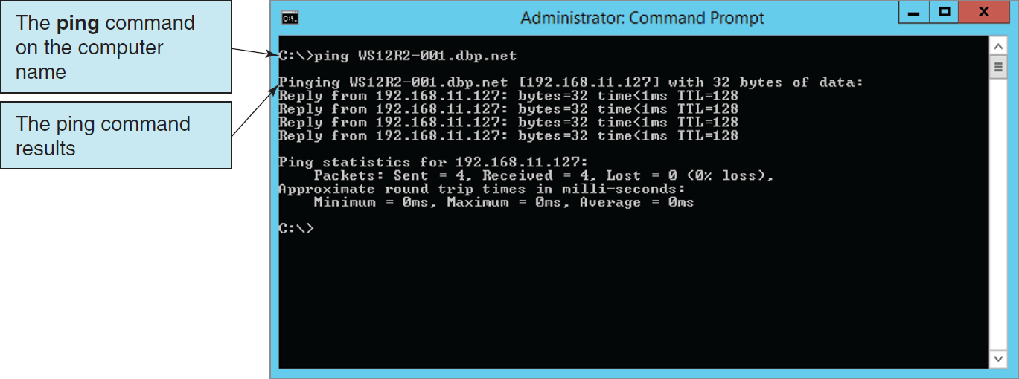
Installing Oracle Database Checking the Loopback Adapter Installation

Slide 12
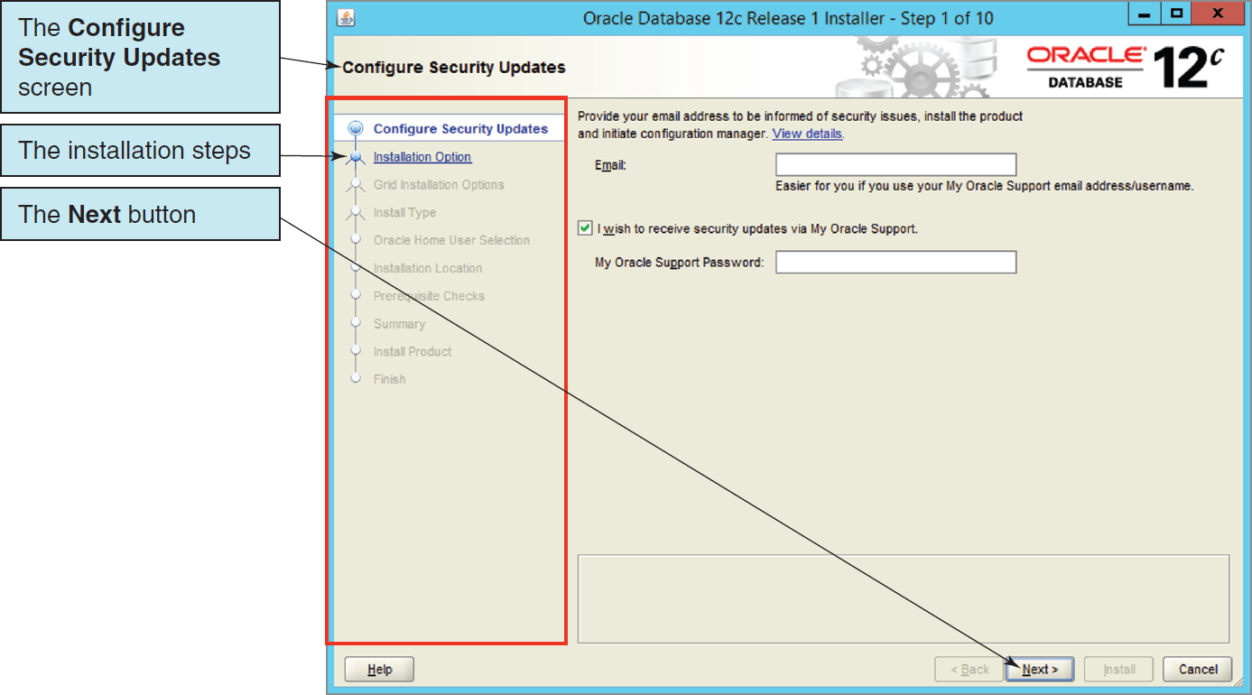
Installing Oracle Database 12c The Initial Oracle Universal Installer (OUI) Screen—Oracle Database 12c
Notes:
This discussion does not include a screenshot of every step in the Oracle Database 12c installation process. Only steps that need clarification are shown.

Slide 13
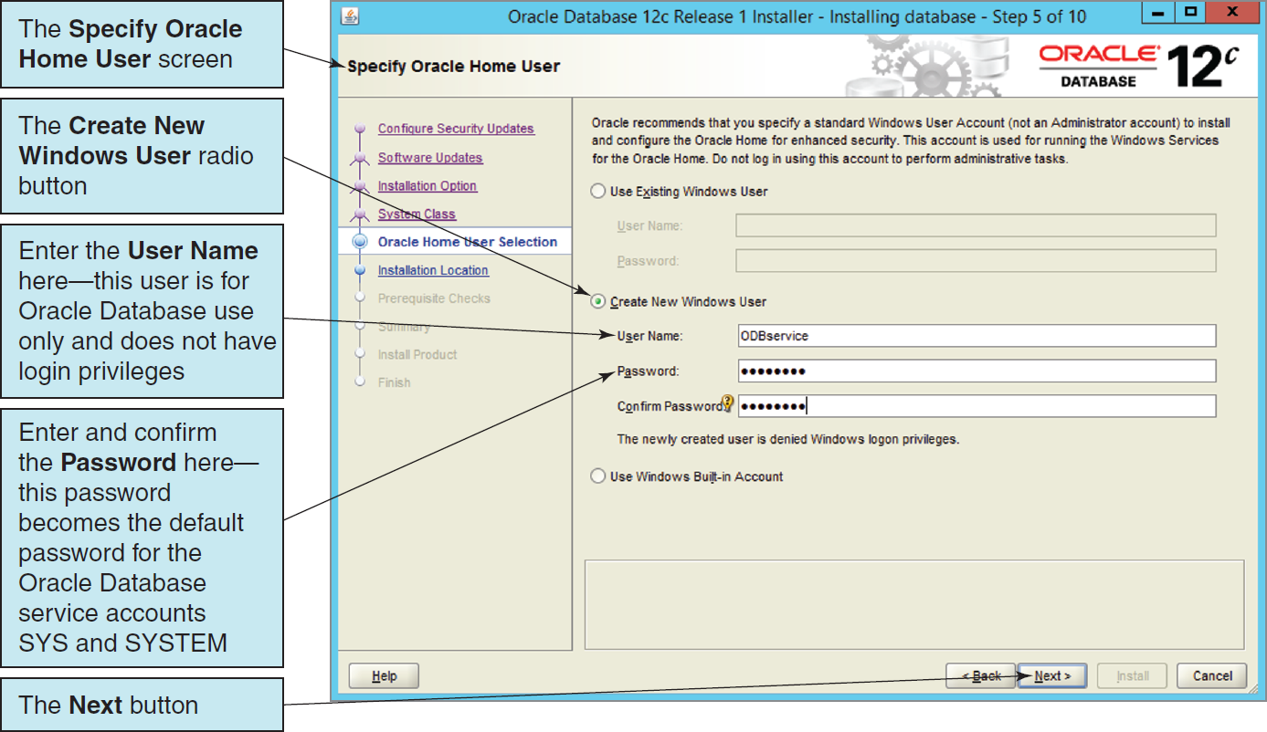
Installing Oracle Database 12c The Specify Oracle Home User Screen
Notes:
In this setup, the needed Oracle Database SYS and SYSTEM user account passwords are initially set up by creating an Oracle Home User with a password (they can be specifically set later in the process). This is done in the Specify Oracle Home User step of the installation process, as shown in this figure.
Note that we created a new user for Oracle Database use only (the account has no Windows login privileges), which we have named ODBservice, and provided that user with a password.
This is the password that the other Oracle Database system accounts will also use unless changed later in the installation process.

Slide 14
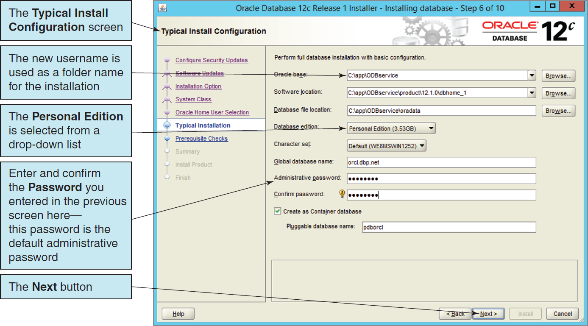
Installing Oracle Database 12c The Typical Install Configuration Screen
Notes:
As shown in this figure, Oracle Database uses the new username as the Oracle Base folder name in the installation process and also requires the use of the new password as the Administrative Password for the rest of the installation.

Slide 15
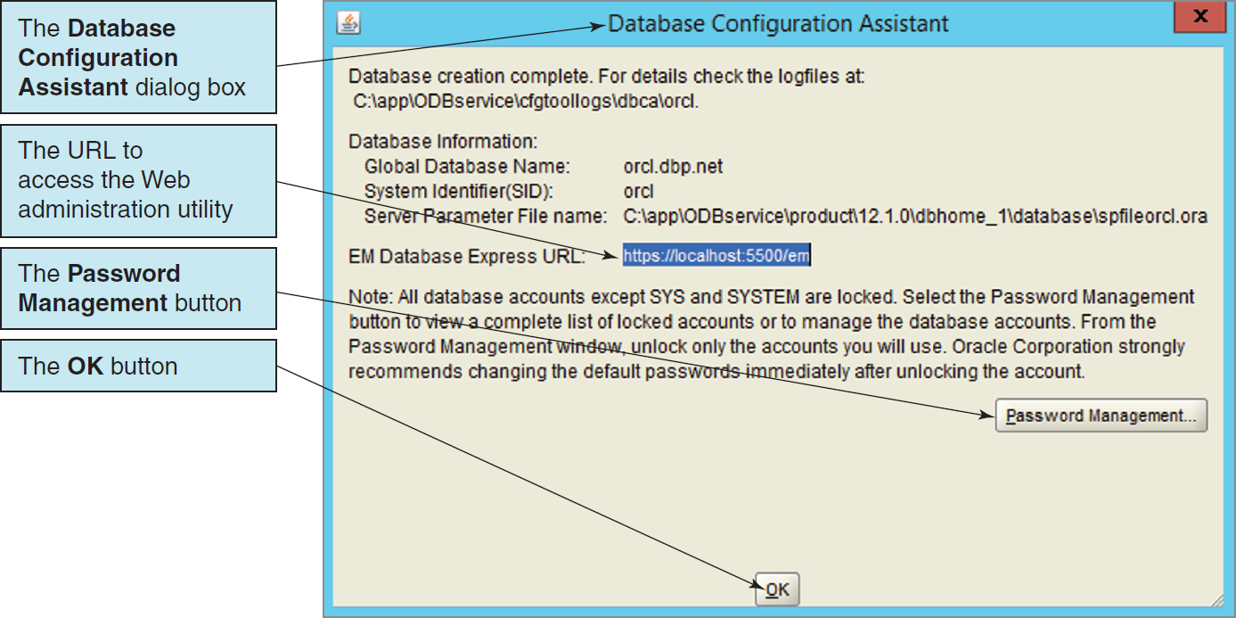
Installing Oracle Database 12c The Database Configuration Assistant Dialog Box
Notes:
As part of the installation process, we specified that a new database instance named orcl should be created.
The orcl database includes a sample database schema (we will discuss Oracle Database schemas later in this chapter) named hr that is used for examples in Oracle Database 12c documentation, and having this schema available will make it easier for you to use the documentation.

Slide 16
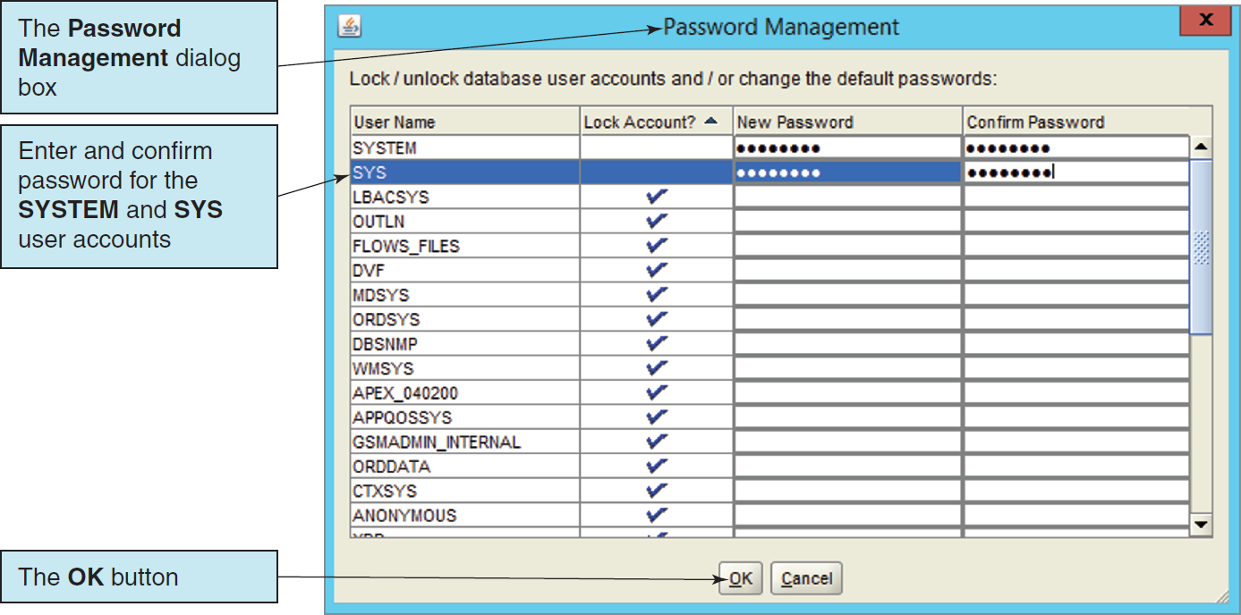
Installing Oracle Database 12c The Password Management Dialog Box

Slide 17
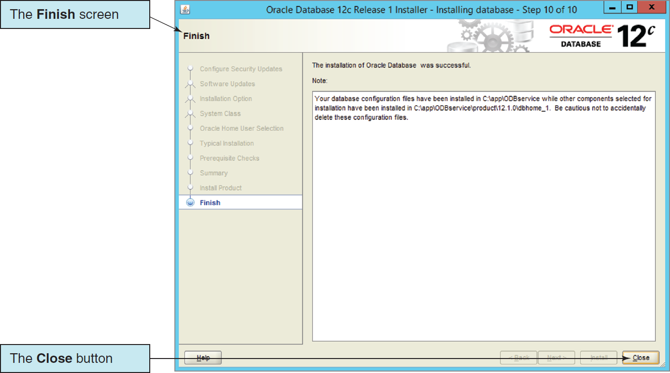
Installing Oracle Database 12c The Finish Screen

Slide 18
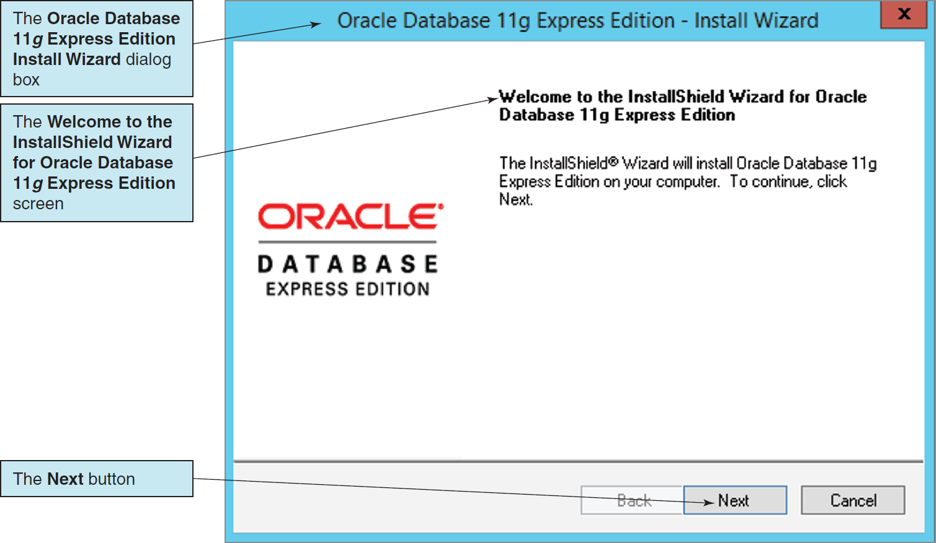
Installing Oracle Database XE The Welcome to the InstallShield Wizard for Oracle Database 11g Express Edition Screen
Notes:
NOTE: The exact name that Oracle uses for Oracle Database Express Edition 11g Release 2 is inconsistent and varies from place to place.
We will write the name that is currently being used when it is displayed in utilities such as the Install Wizard but will consider Oracle Database Express Edition 11g Release 2 as the correct name and use it as the full product name.
We will continue to use Oracle Database XE as our preferred name in this chapter unless a variant is indicated.

Slide 19
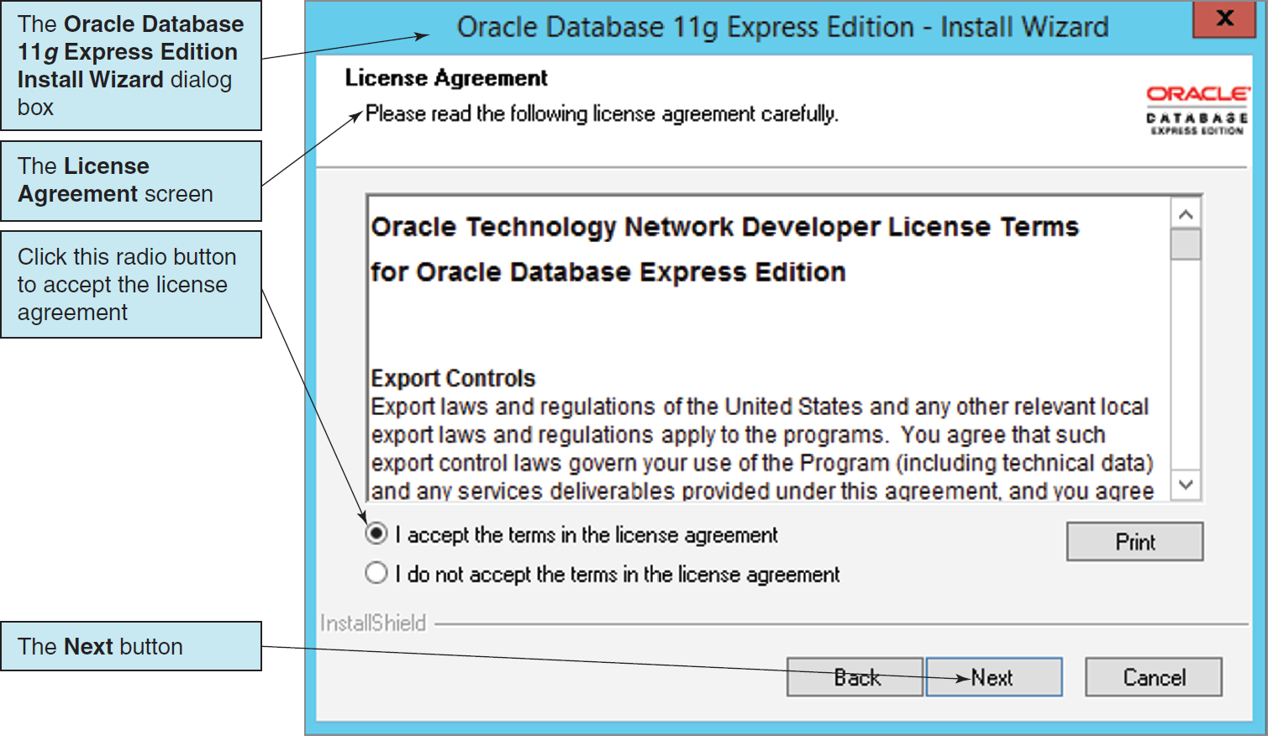
Installing Oracle Database XE The License Agreement Screen

Slide 20
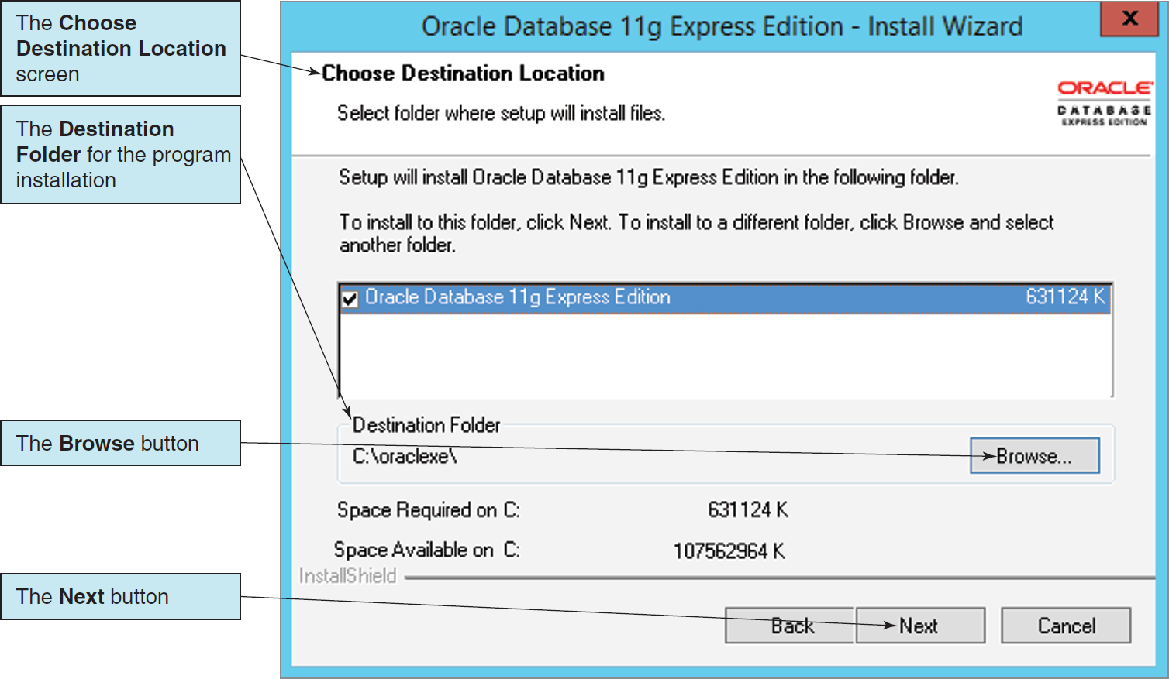
Installing Oracle Database XE The Choose Destination Location Screen

Slide 21
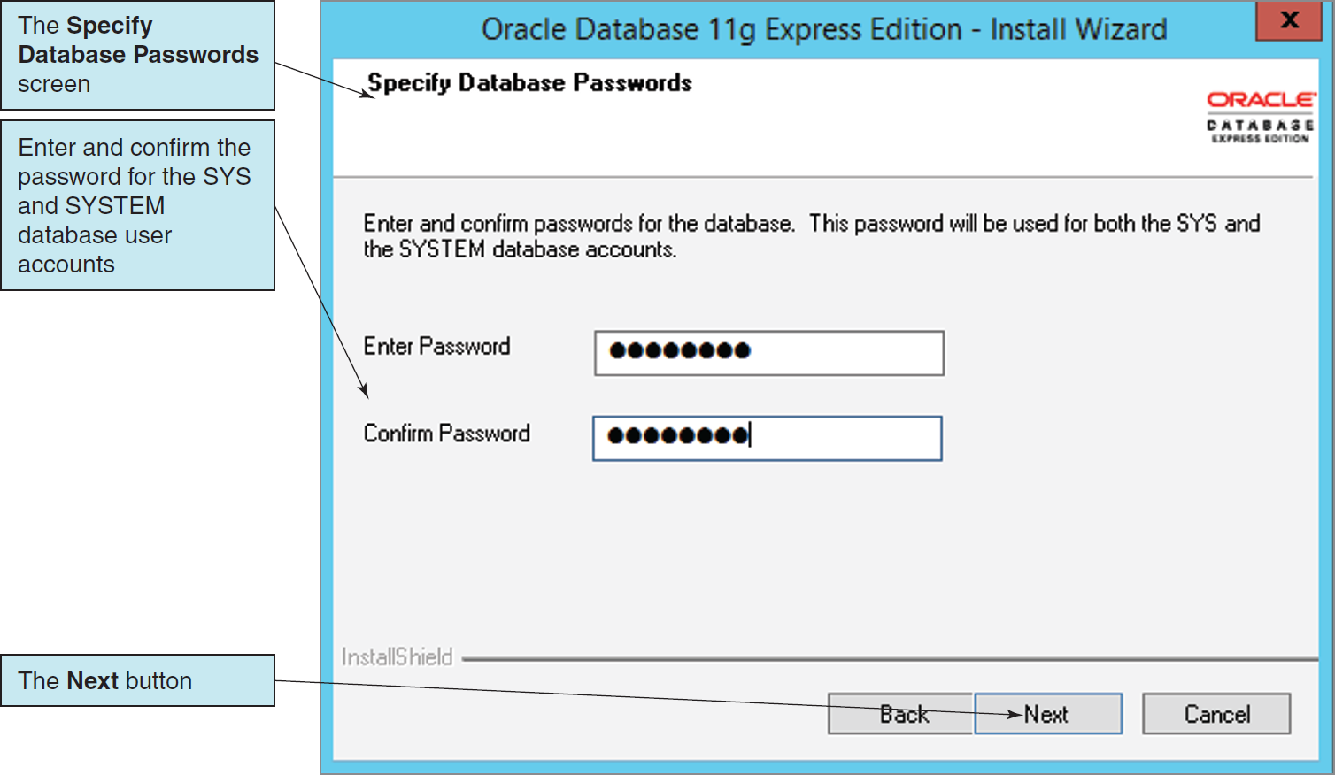
Installing Oracle Database XE The Specify Database Passwords Screen

Slide 22
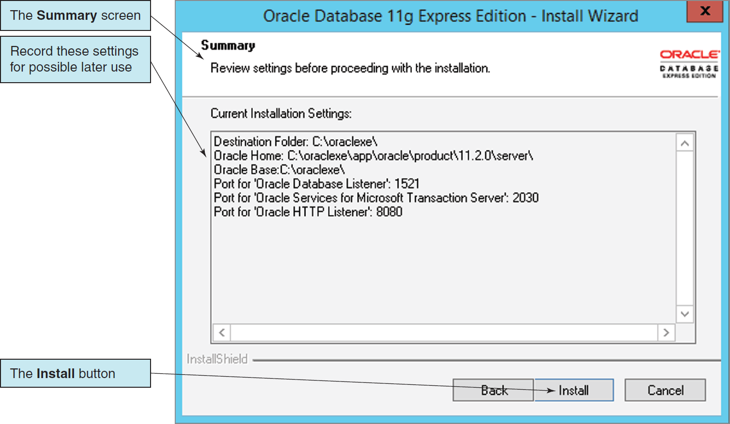
Installing Oracle Database XE The Summary Screen

Slide 23
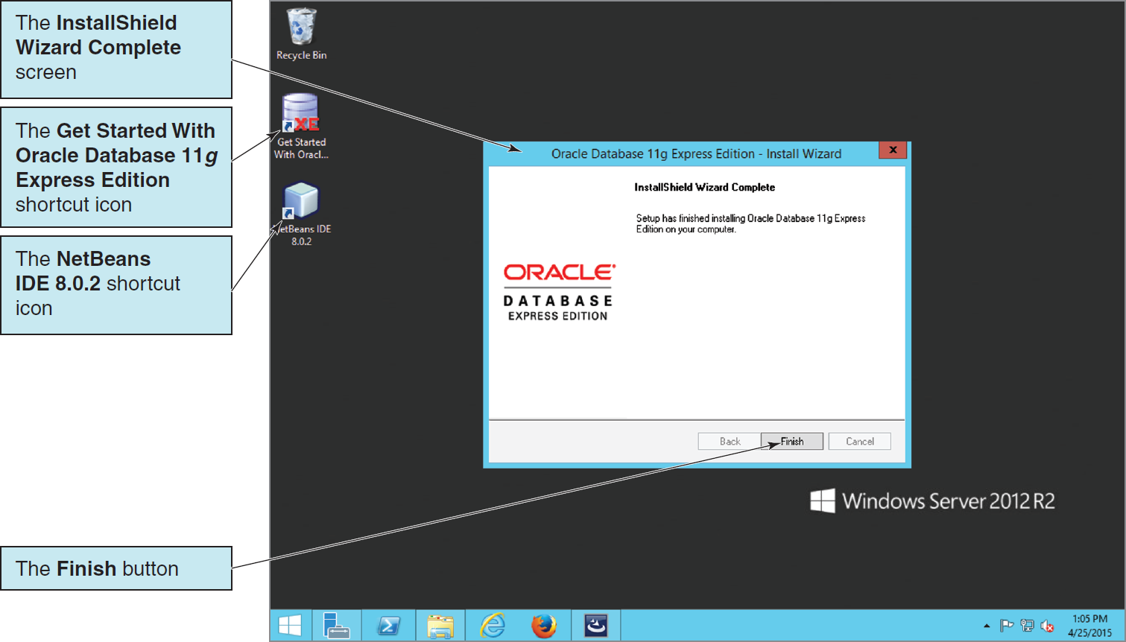
Installing Oracle Database XE The InstallShield Wizard Complete Screen

Slide 24
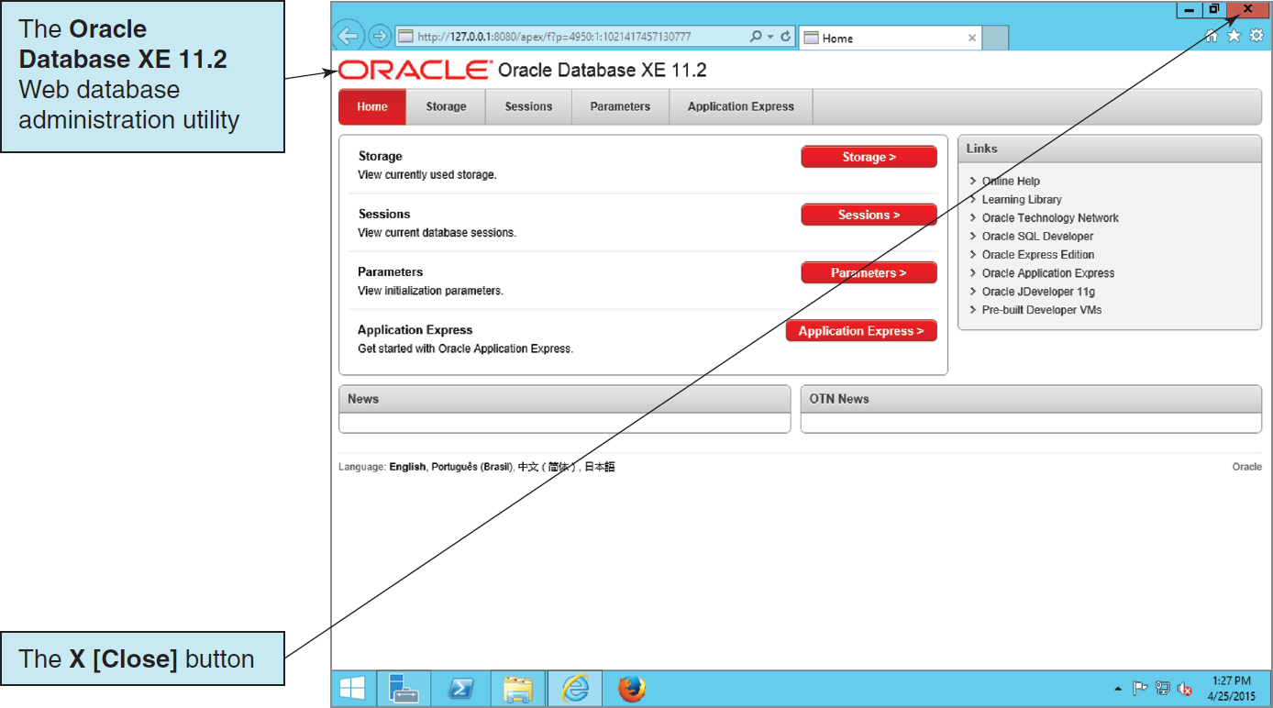
Installing Oracle Database XE The Oracle Database XE 11.2 Web Administration Utility

Slide 25
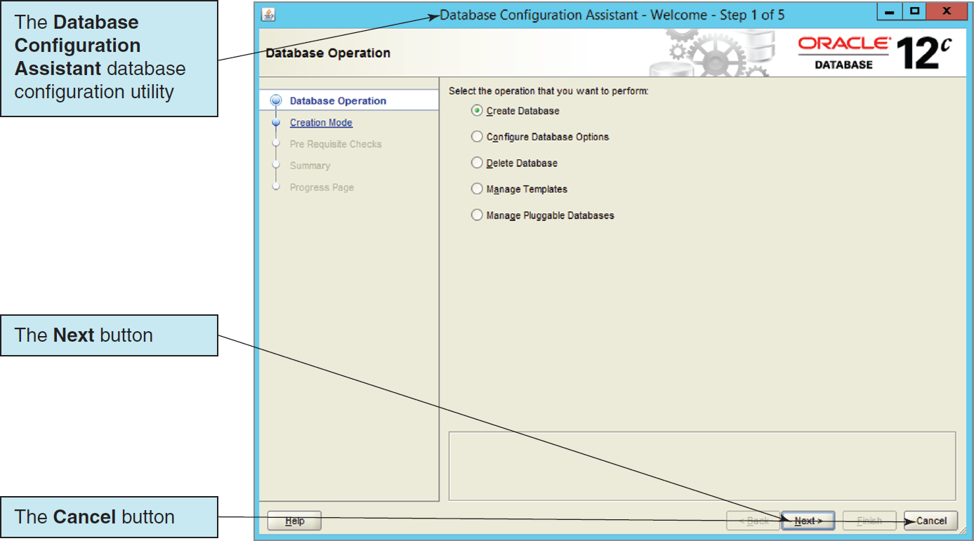
Oracle Database Administration and Development Tools The Oracle Database 12c Configuration Assistant

Slide 26
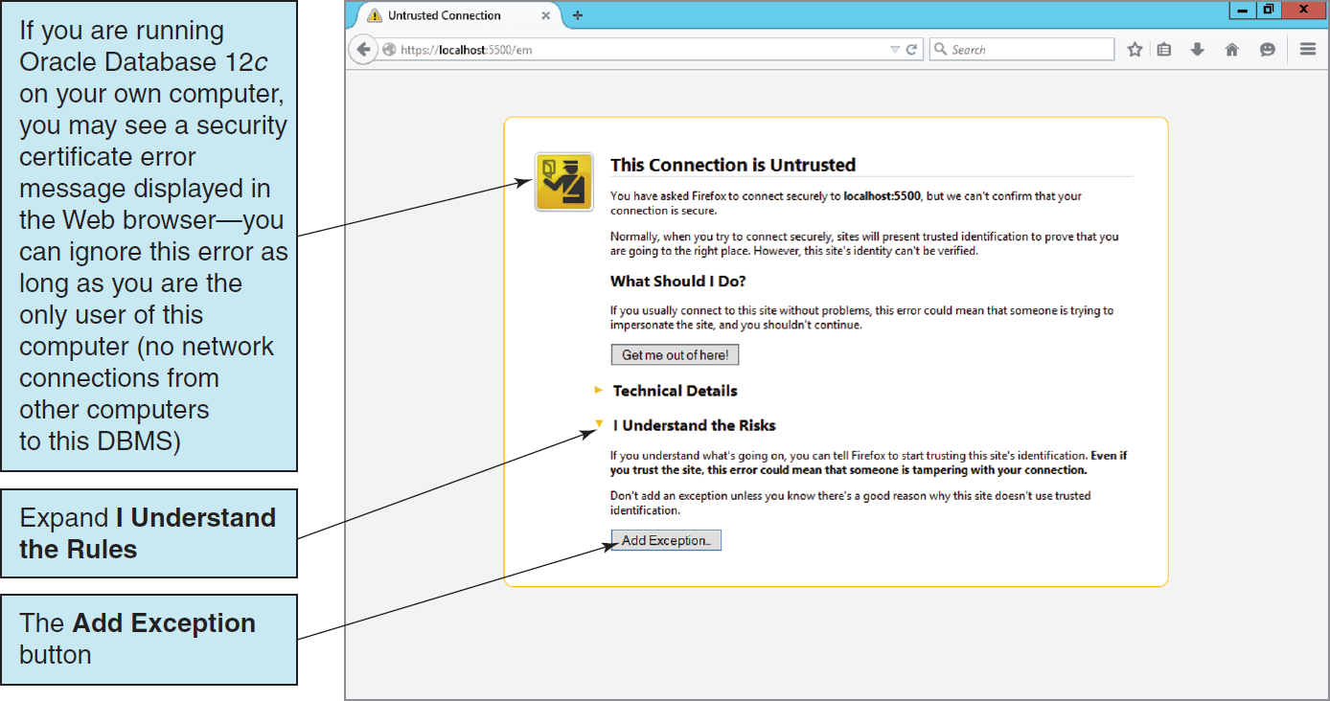
Oracle Database Administration and Development Tools The Oracle Enterprise Manager Database Express 12c Database Administration Utility I

Slide 27
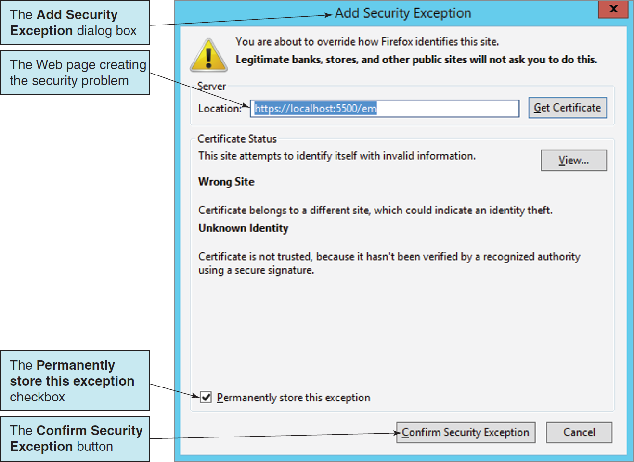
Oracle Database Administration and Development Tools The Oracle Enterprise Manager Database Express 12c Database Administration Utility II

Slide 28
Oracle Database Administration and Development Tools The Oracle Enterprise Manager Database Express 12c Database Administration Utility III
Oracle Database 12c separates database administration into a parent Container Database (CDB) and a child Pluggable Database (PDB).
One CDB can work with (contain) one or more PDBs.
Intended to create database administration efficiencies by storing common Oracle Database objects in the CDB and Database-specific objects in each PDB.
Increases the complexity of Oracle Database 12c administration
Requires movement between the CDB and the PDB Enterprise Manager Web sites that was never required before.

Slide 29
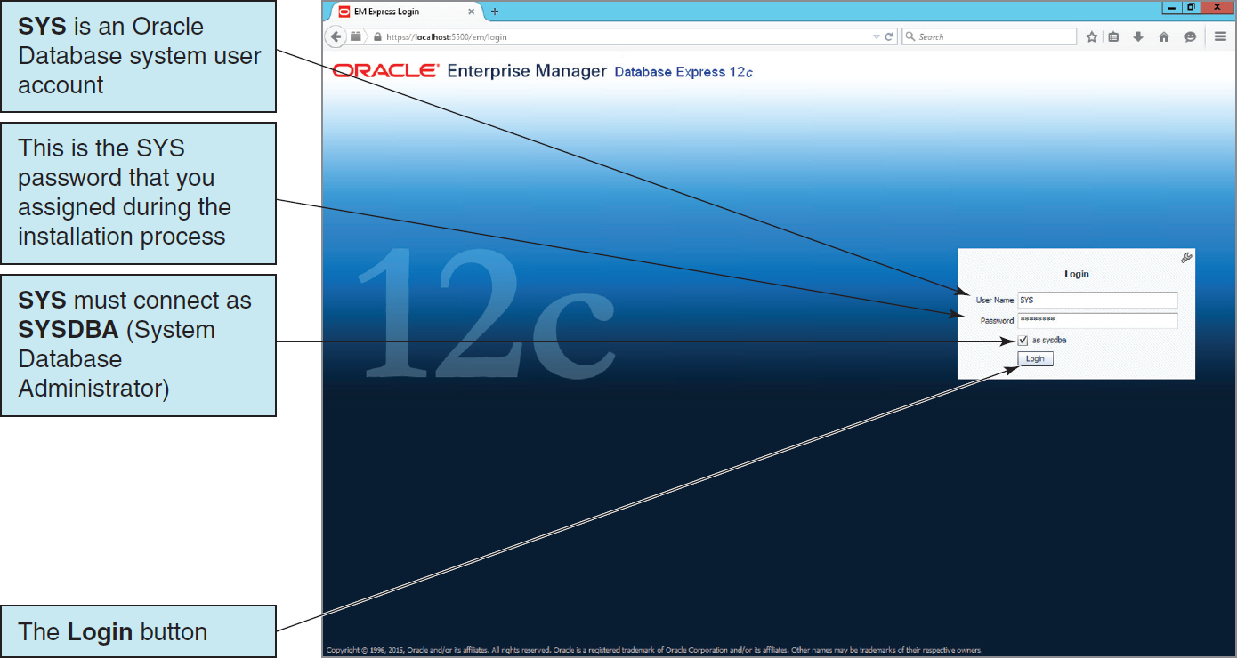
Oracle Database Administration and Development Tools The Oracle Enterprise Manager Database Express 12c Database Administration Utility IV

Slide 30
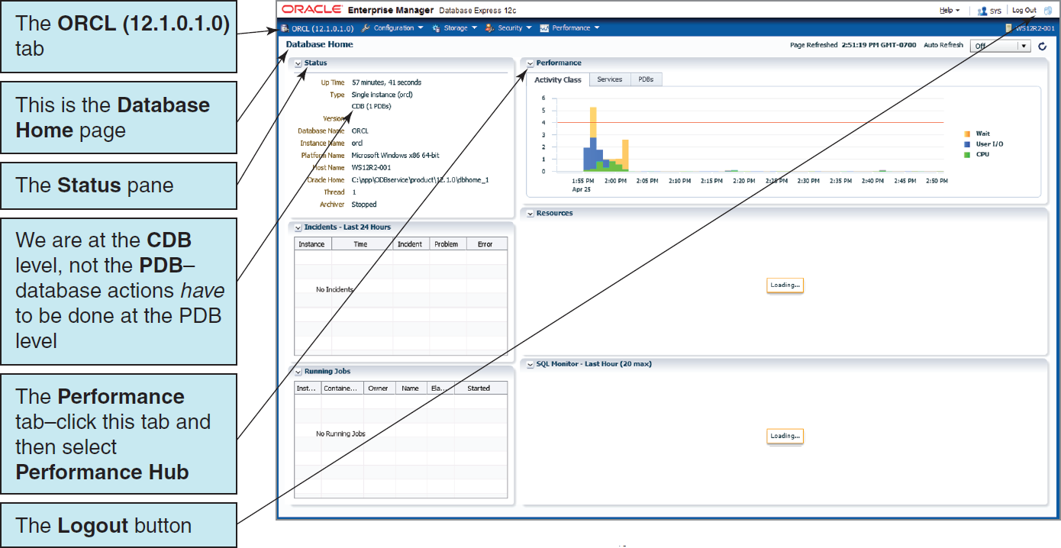
Oracle Database Administration and Development Tools The Oracle Enterprise Manager Database Express 12c Database Administration Utility V

Slide 31
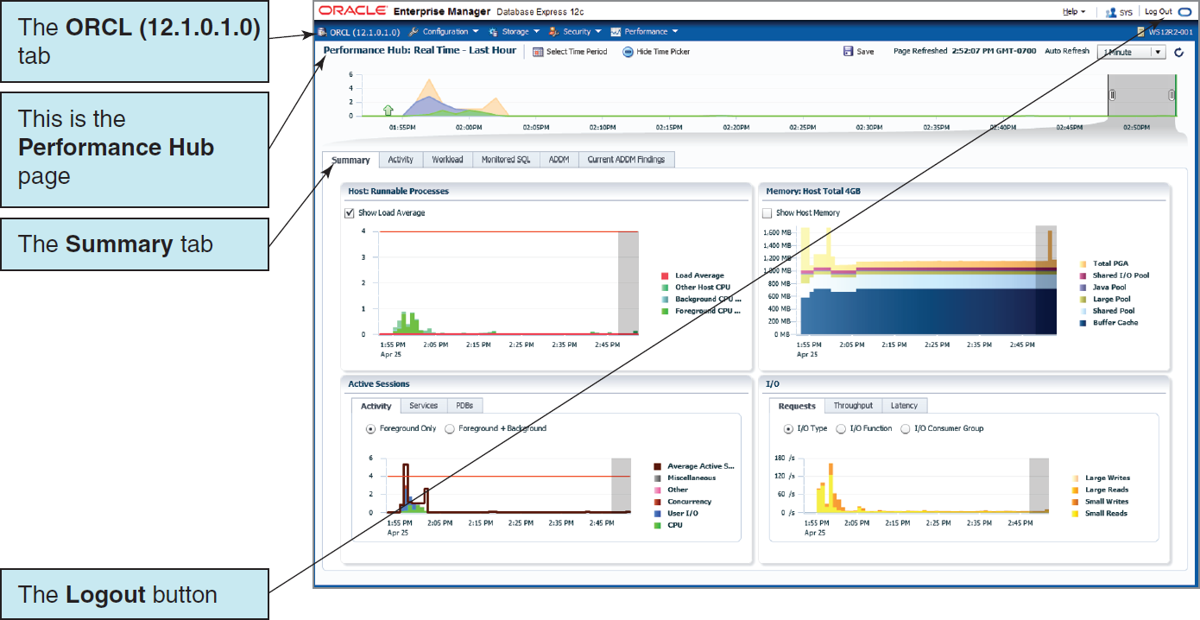
Oracle Database Administration and Development Tools The Oracle Enterprise Manager Database Express 12c Database Administration Utility VI

Slide 32
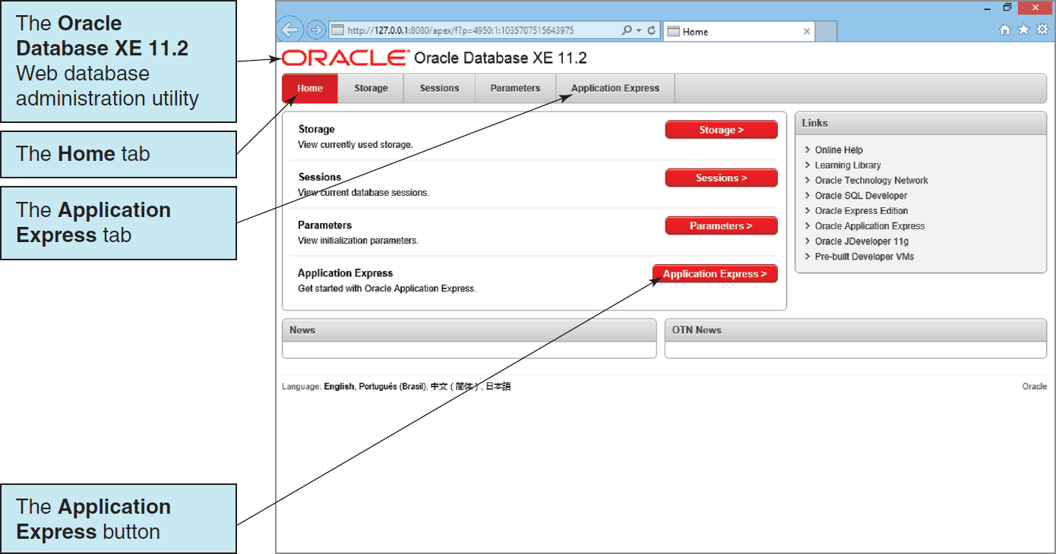
Oracle Database Administration and Development Tools The Oracle Database XE 11.2 Database Administration Utility I

Slide 33
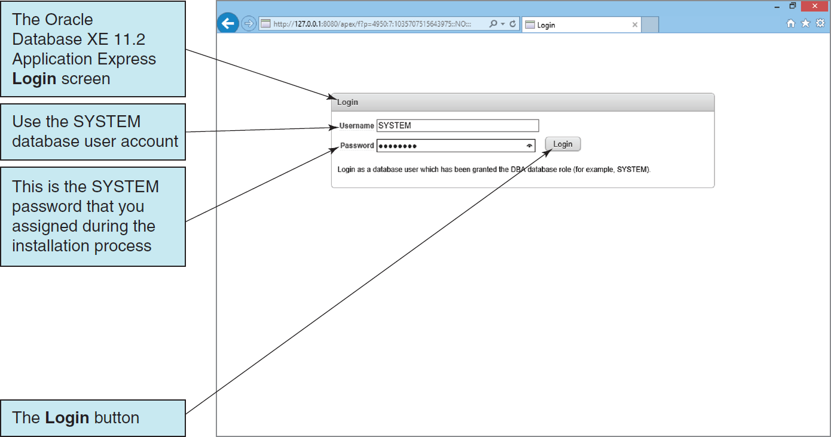
Oracle Database Administration and Development Tools The Oracle Database XE 11.2 Database Administration Utility II

Slide 34
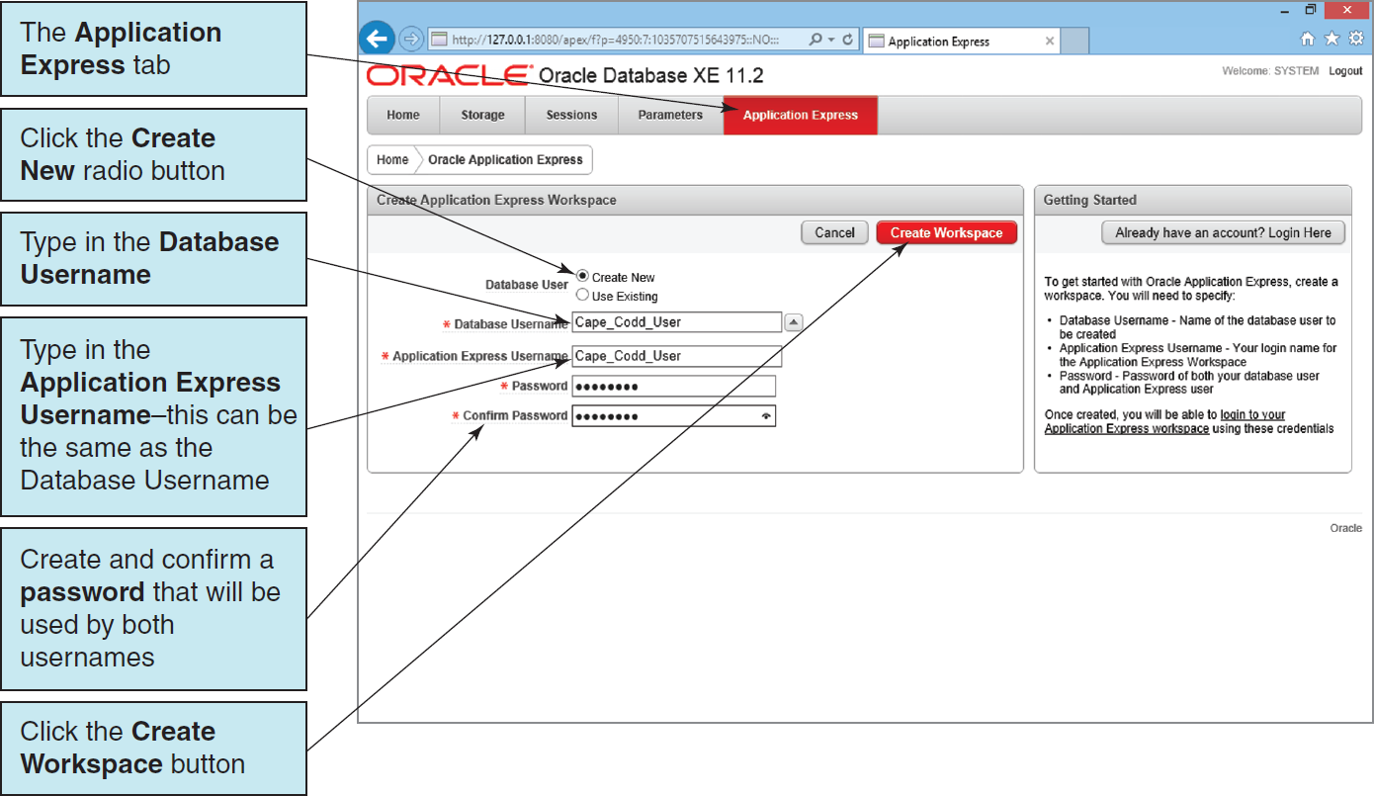
Oracle Database Administration and Development Tools The Oracle Database XE 11.2 Database Administration Utility III

Slide 35
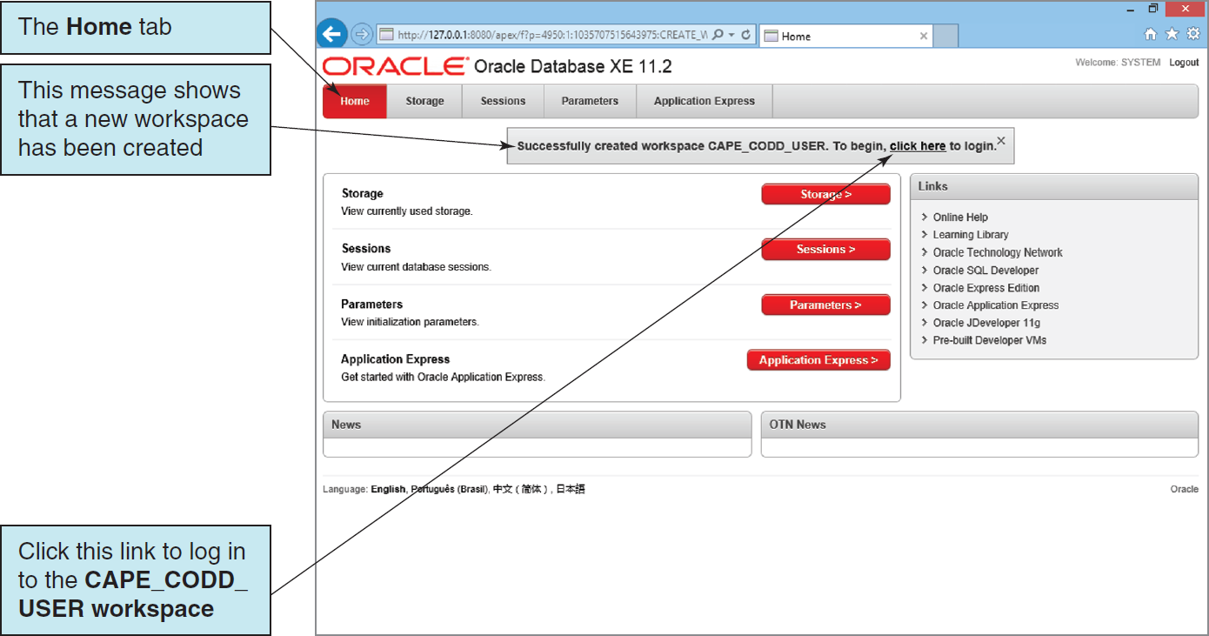
Oracle Database Administration and Development Tools The Oracle Database XE 11.2 Database Administration Utility IV

Slide 36
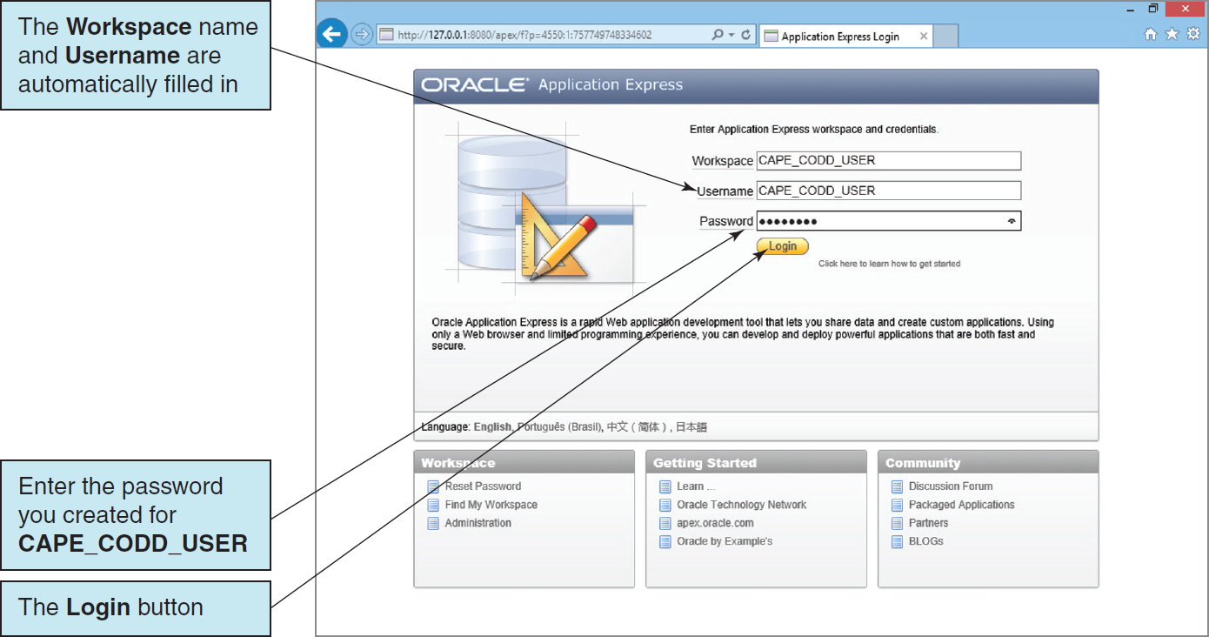
Oracle Database Administration and Development Tools The Oracle Database XE 11.2 Database Administration Utility V

Slide 37
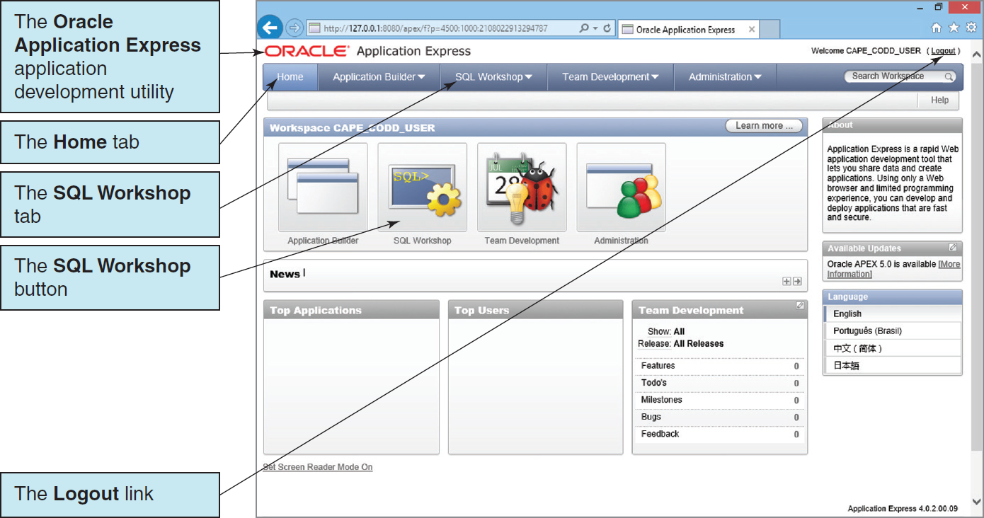
Oracle Database Administration and Development Tools The Oracle Database XE 11.2 Database Administration Utility VI

Slide 38
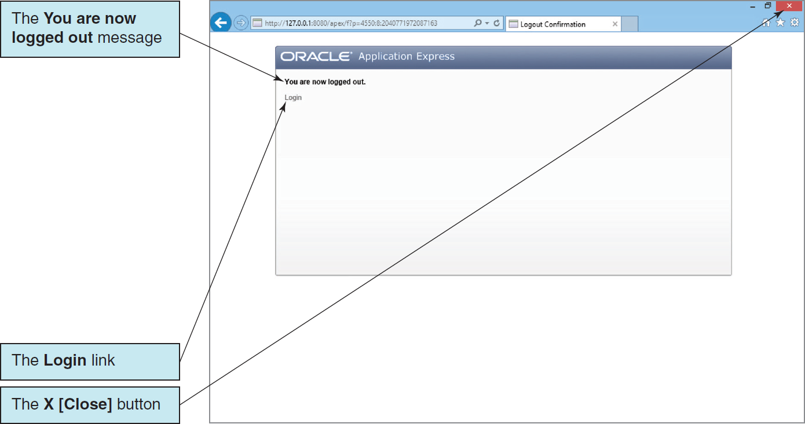
Oracle Database Administration and Development Tools The Oracle Database XE 11.2 Database Administration Utility VII

Slide 39
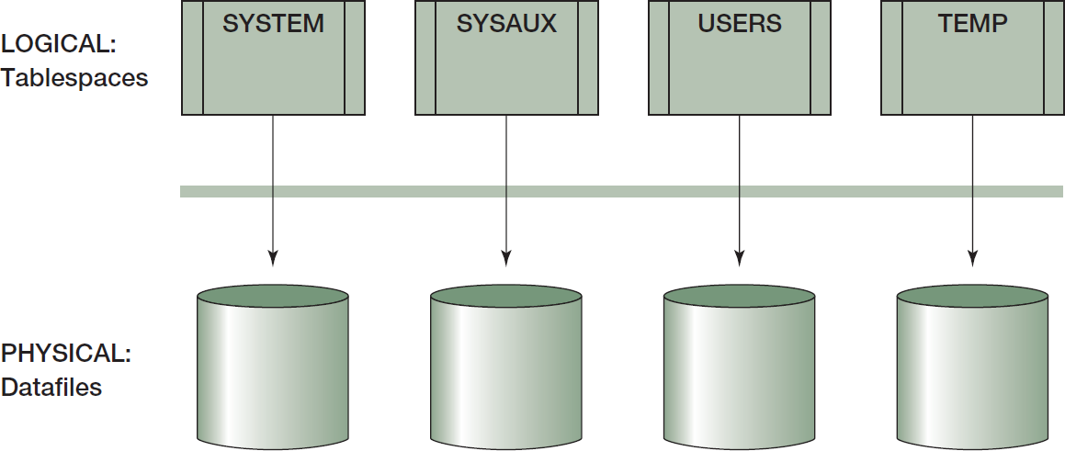
Tablespaces I

Slide 40
Tablespaces II
The USERS tablespace is the default space for the nonsystem objects created by Oracle Database users.
For Oracle Database 12c, we could keep the CAPE_CODD objects in the USERS tablespace, but a better practice is to create a separate tablespace for each database application.
This must be done in the PDB holding the database.
For Oracle Database XE, we do not need to create any tablespaces, and we do not need to assign tablespaces to users. That is all done automatically.

Slide 41
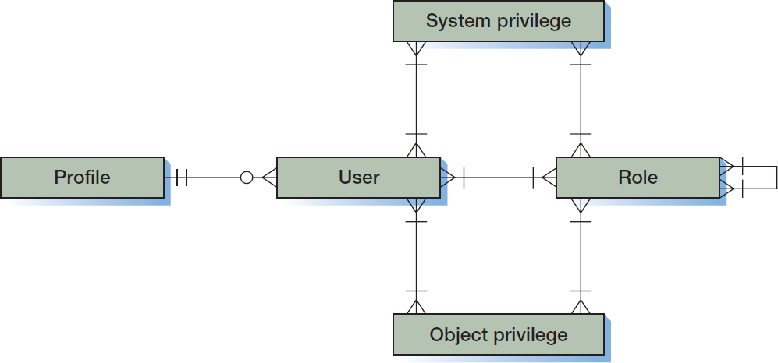
Oracle Security
Oracle security components:
A USER is a user account.
A PROFILE is a set of system resource maximums that are assigned to an account.
A SYSTEM PRIVILEGE is the right to perform a task.
An OBJECT PRIVILEGE is the right to work with that object.
A ROLE consists of groups of PRIVILEGEs and other ROLEs.

Slide 42
USER System Privileges
Each USER can be allocated many SYSTEM PRIVILEGEs, OBJECT PRIVILEGEs and ROLEs.
A USER account has all the PRIVILEGEs:
That have been assigned directly
Of all of its ROLEs
Of all of its ROLEs that are inherited through ROLE connections
A ROLE can have many SYSTEM PRIVILEGEs and OBJECT PRIVILEGEs, and it may also have a relationship to other ROLEs.
ROLEs simplify the administration of the database:
A set of privileges can be assigned to or removed from a ROLE just once.

Slide 43
Users, Roles, and Privileges I
To create a new user account:
For Oracle Database 12c, the Enterprise Manager is used to create a new user account.
For Oracle Database Express Edition 11g Release 2, the new user account is created when we create a new Oracle Application Express workspace as discussed above.
We have already created the CAPE_CODD_USER user account in Oracle Application Express.

Slide 44
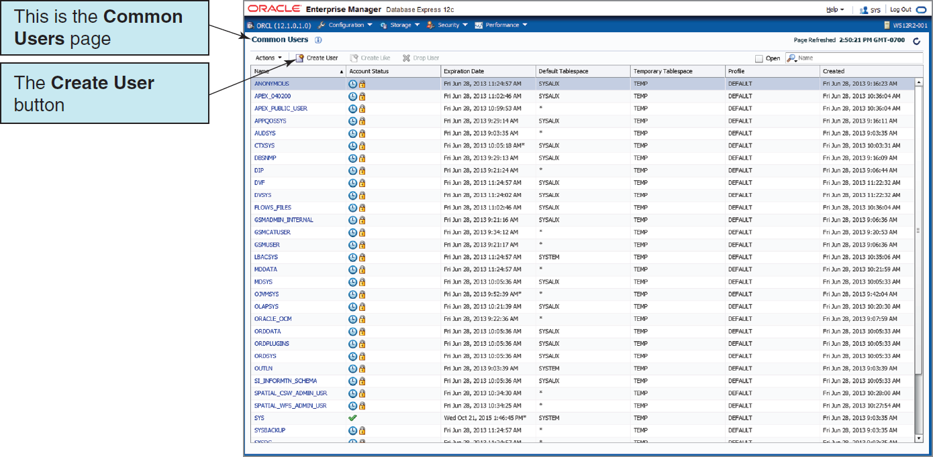
Users, Roles, and Privileges II

Slide 45
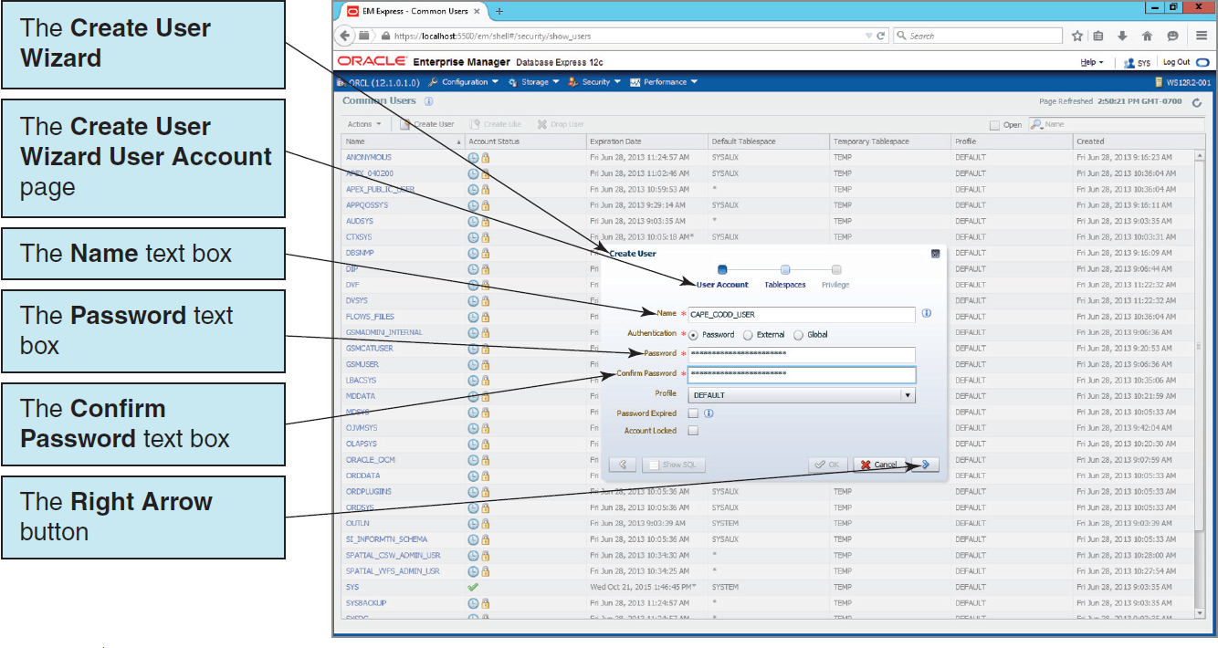
Users, Roles, and Privileges III

Slide 46
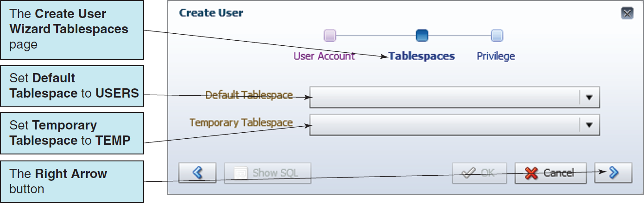
Users, Roles, and Privileges IV

Slide 47
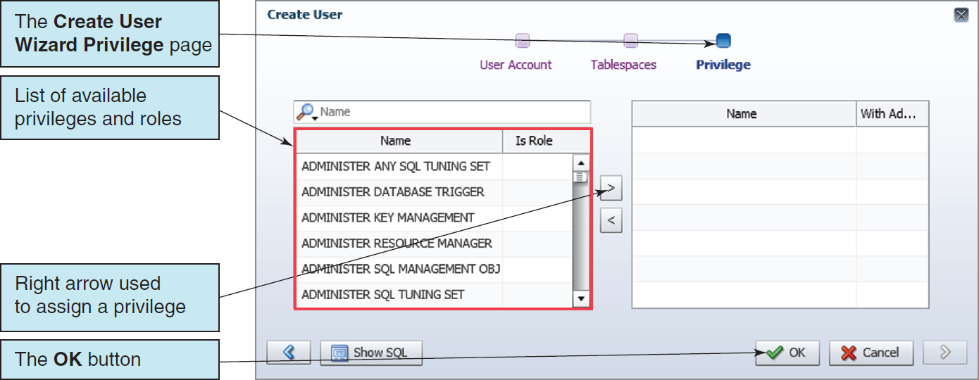
Users, Roles, and Privileges V

Slide 48
Users, Roles, and Privileges VI
To create a new common role:
For Oracle Database 12c, the RESOURCE Role does not include the CREATE VIEW System privilege.
When creating CAPE_CODD_USER for Oracle Database Express Edition 11g Release 2 in Oracle Database XE 11.2, we did not worry about assigning roles—the main users created in Oracle Application Express have sufficient database privileges that we do not need to worry about specific roles.

Slide 49
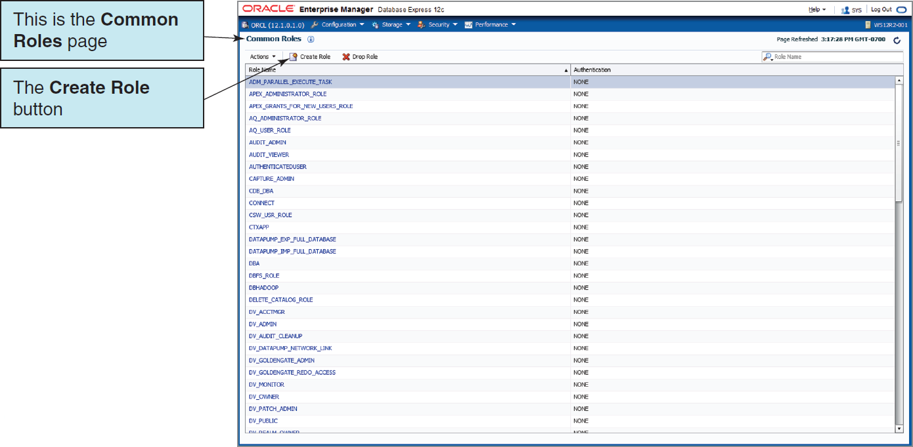
Users, Roles, and Privileges VII

Slide 50
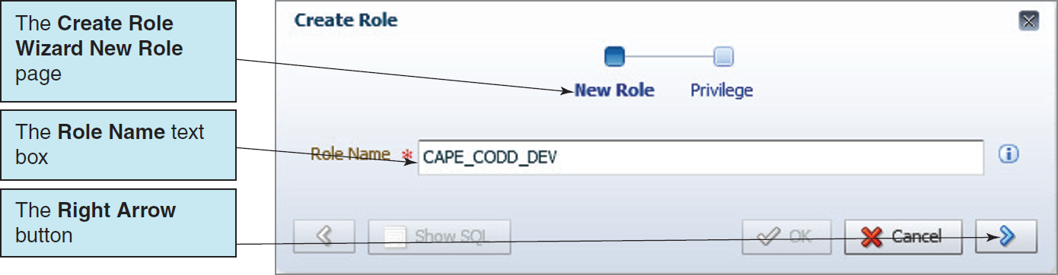
Users, Roles, and Privileges VIII

Slide 51
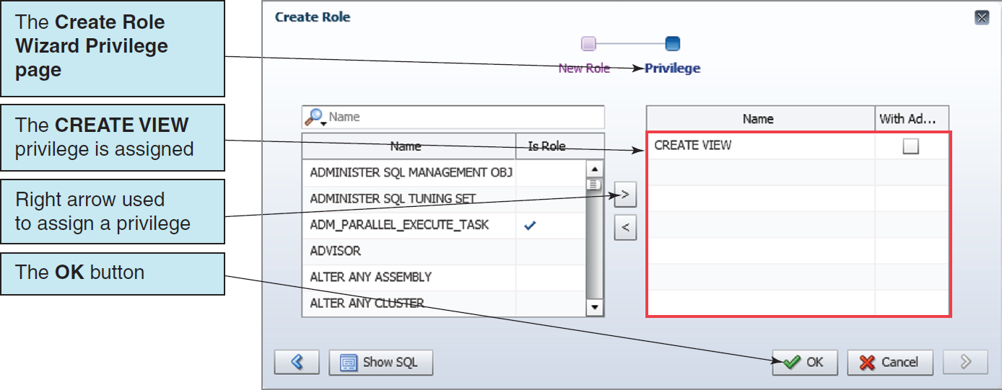
Users, Roles, and Privileges IX

Slide 52
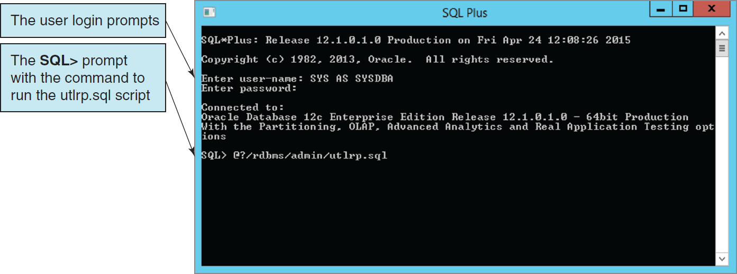
Oracle Database Application Development Tools Oracle Database SQL*Plus

Slide 53
Oracle Database Application Development Tools Oracle SQL Developer I
For Oracle Database 12c:
A version is installed as part of the DBMS installation.
Download and install the latest version of SQL Developer and use it instead.
For Oracle Database XE:
Download and install SQL Developer separately.
Start it by finding the . .\sqldeveloper\sqldeveloper.exe file in the installation folder (directory), right-clicking to pin this icon to the task bar, and then clicking the icon on the task bar.
Now we can just start it from the task bar.
In order to use SQL Developer, you must first install the Java Developer Kit (JDK).
Note that when Oracle asks for a System Identifier (SID), it is asking for the database instance name, in this case:
■ For Oracle Database 12c, the SID is orcl.
■ For Oracle Database XE, the SID is xe.
Notes:
. Note: If this doesn’t work in your installation of Oracle Database XE, try specifying a service name instead of an SID, and use the default service name of XEXDB.

Slide 54
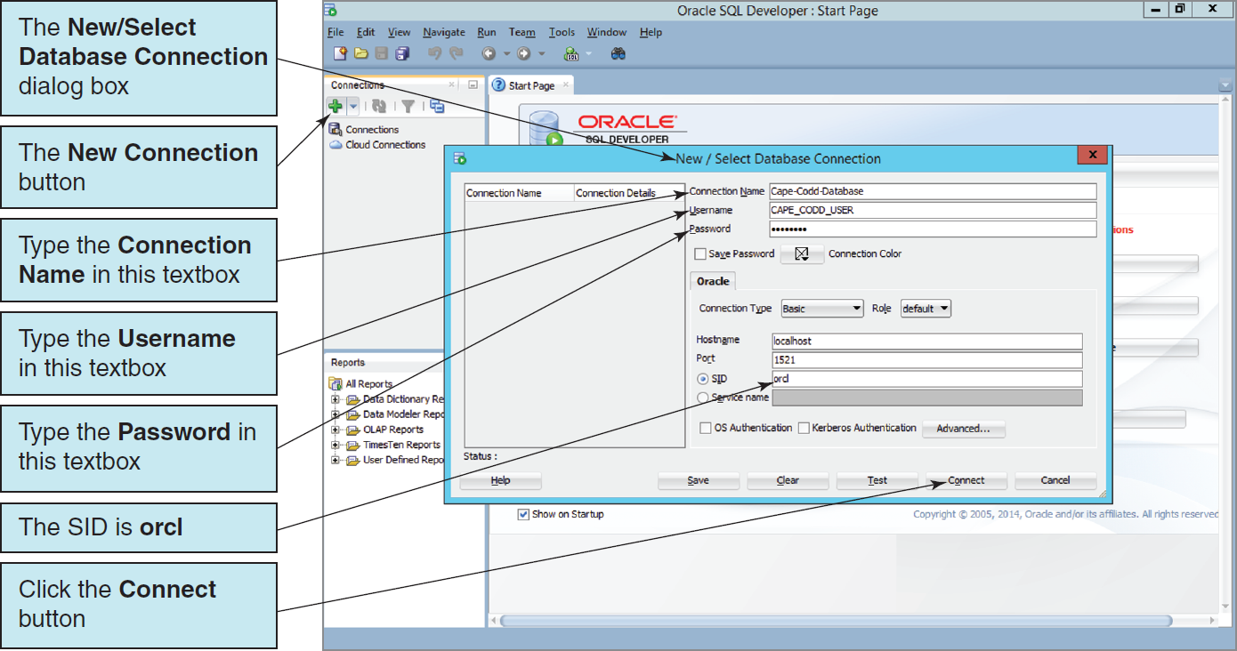
Oracle Database Application Development Tools Oracle Database 12c Cape-Codd-Database Connection

Slide 55

Oracle Database Application Development Tools Oracle Database XE Cape-Codd-Database Connection

Slide 56
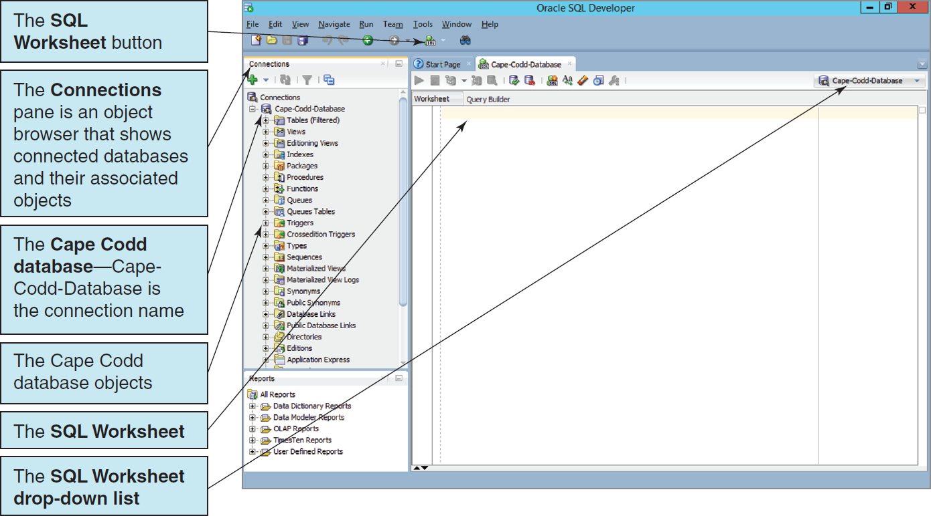
Oracle Database Application Development Tools The Cape Codd Database in SQL Developer

Slide 57
We are Working with Oracle Database XE!
From this point on, we are working exclusively with:
Oracle Database XE
SQL Developer

Slide 58
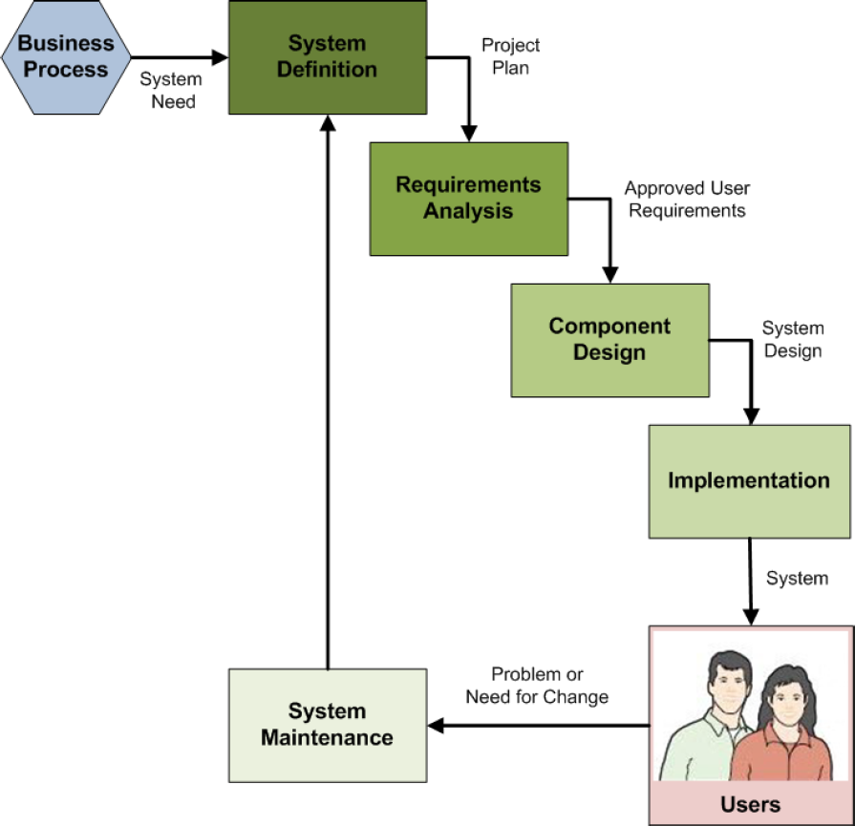
Database Implementation in the SDLC
The systems development life cycle (SDLC) as discussed in Appendix B
Database construction occurs in the implementation step of the SDLC
The final database is part of the final system ready for users to use
Notes:
Books on systems analysis and design often identify three design stages:
■ Conceptual design (conceptual schema)
■ Logical design (logical schema)
■ Physical design (physical schema)
The creation and use of file structure and file organization (including physical storage placement and file characteristics) to store database components and physical records of data are a part of the physical design, which is defined in these books as the aspects of the database that are actually implemented in the DBMS. Besides physical record and file structure and organization, this includes indexes and query optimization.

Slide 59
SQL Scripts
An SQL script is a plaintext file labeled with the .sql file extension.
An SQL script is composed of one or more SQL statements, which can include SQL script comments.
SQL script comments are lines of text that do not run when the script is executed but are used to document the purpose and contents of the script. Each comment begins with the characters /* (slash asterisk) and ends with the characters */ (asterisk slash). Alternatively, for a single line comment (or a comment at the end of a line), we use – – (two dashes) at the start of the comment.

Slide 60
Cape Codd Database Available Online
Another advantage of SQL scripts is that we can use scripts written by others.
Versions of the complete Cape Codd database are available in the downloadable Student Files available at:
http://www.pearsonhighered.com/kroenke/
These include versions for:
Microsoft Access 2013
Microsoft SQL Server 2014
Oracle Database 12c and Oracle Database XE
MySQL 5.6
We recommend you actually run all material in a live database!

Slide 61
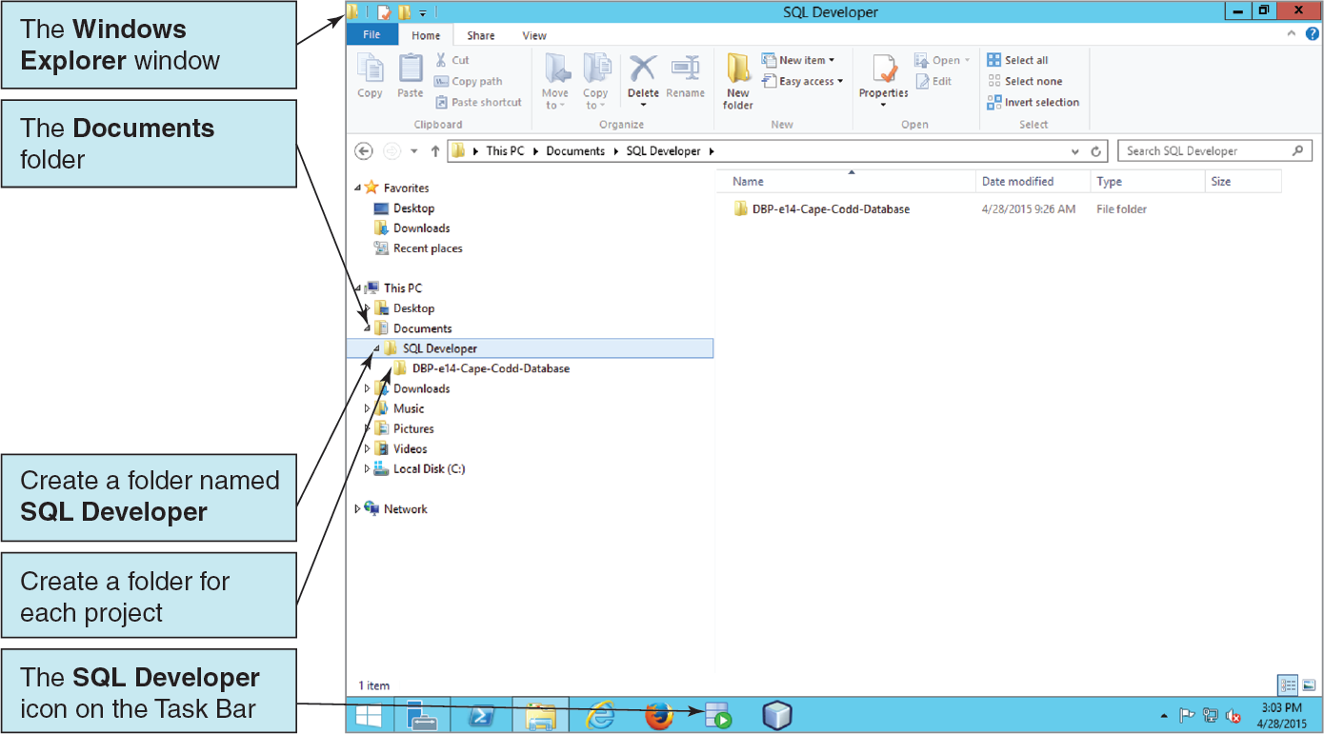
Using Existing SQL Scripts Creating the File System Structure

Slide 62
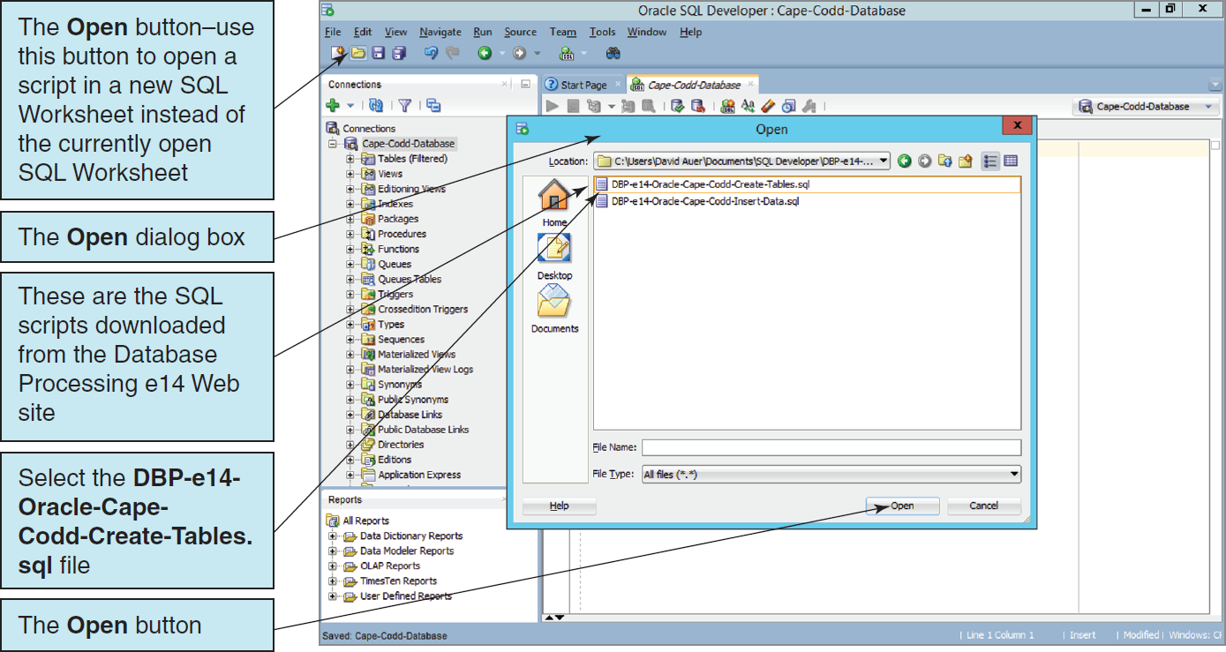
Using Existing SQL Scripts The Open Dialog Box

Slide 63
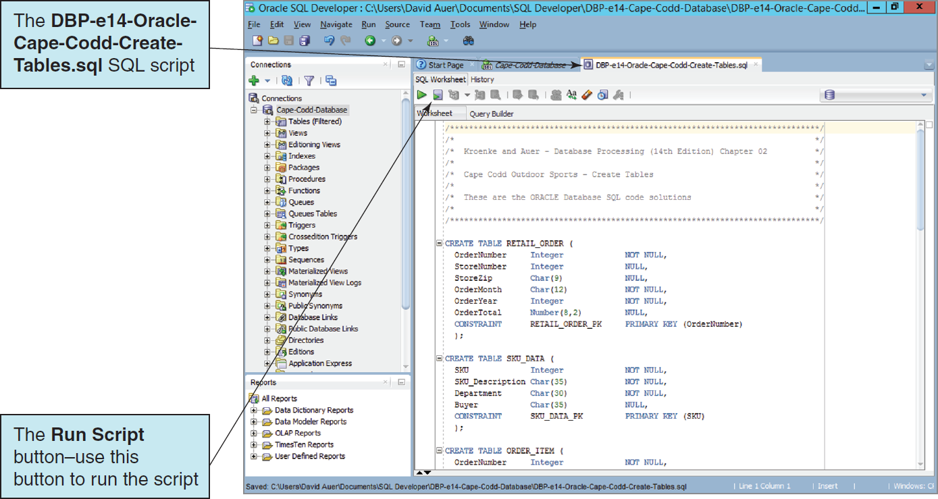
Using Existing SQL Scripts The Cape Codd Database Create Tables Script

Slide 64
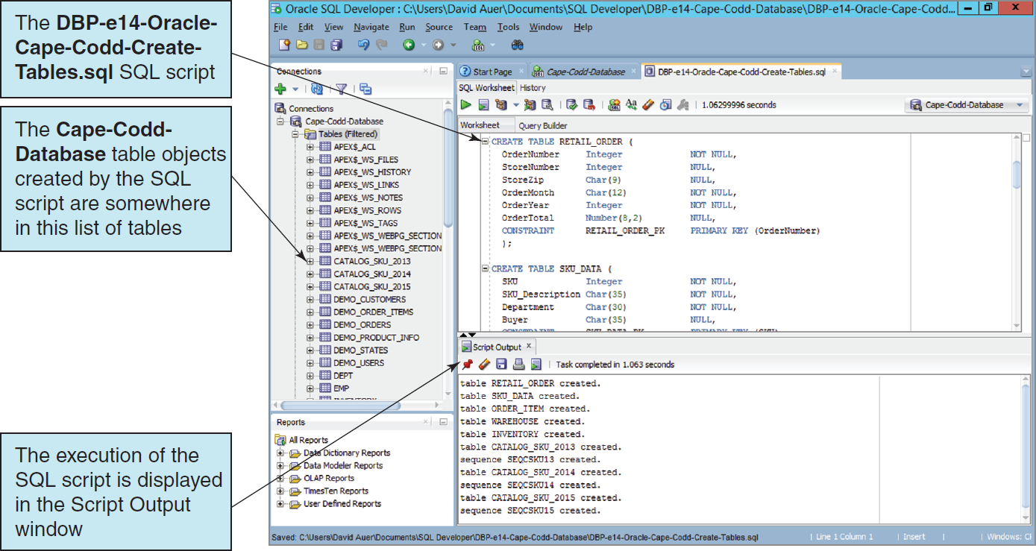
Using Existing SQL Scripts The Cape Codd Database Table Objects in the Navigator

Slide 65
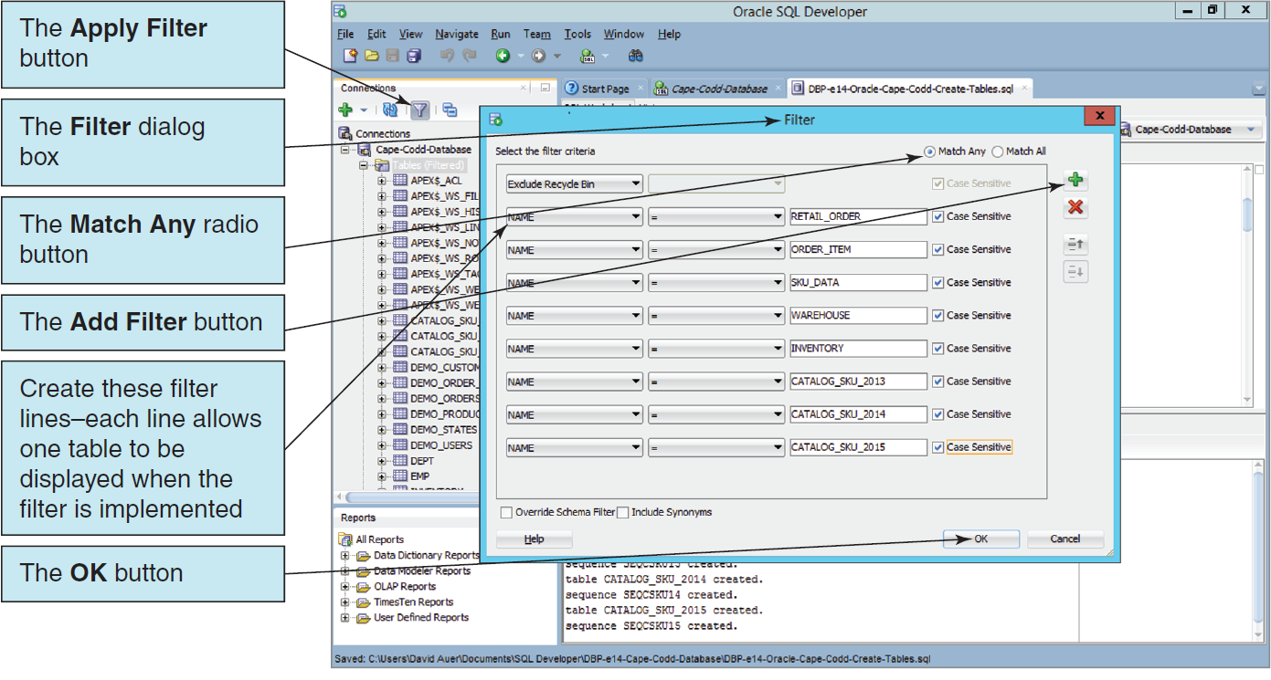
Using Existing SQL Scripts The Filter Dialog Box

Slide 66
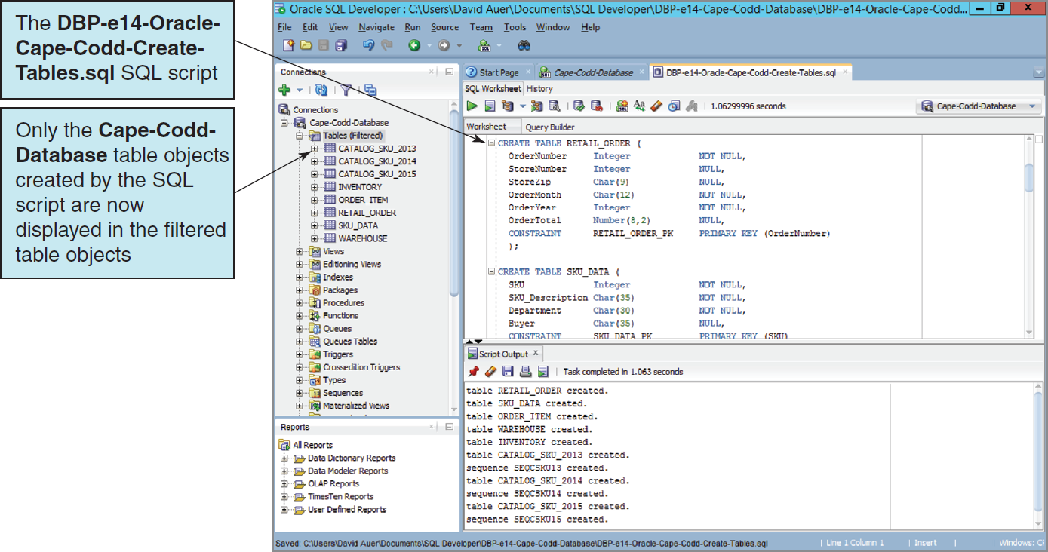
Using Existing SQL Scripts The Filtered Cape Codd Database Tables

Slide 67
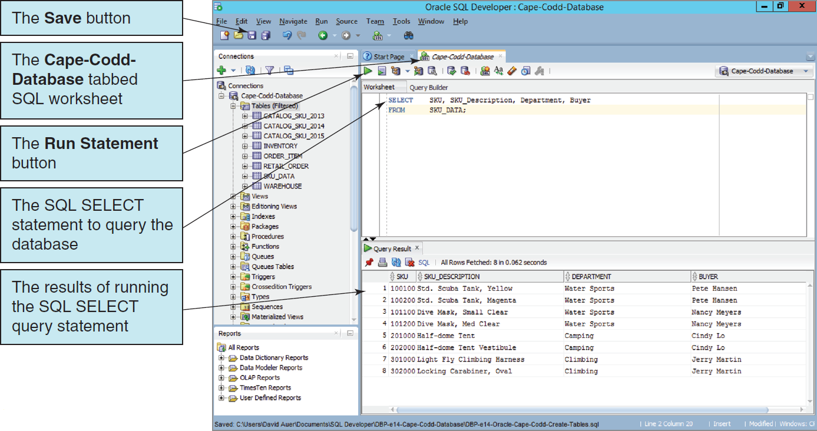
Using Existing SQL Scripts Querying the Cape Codd Database

Slide 68
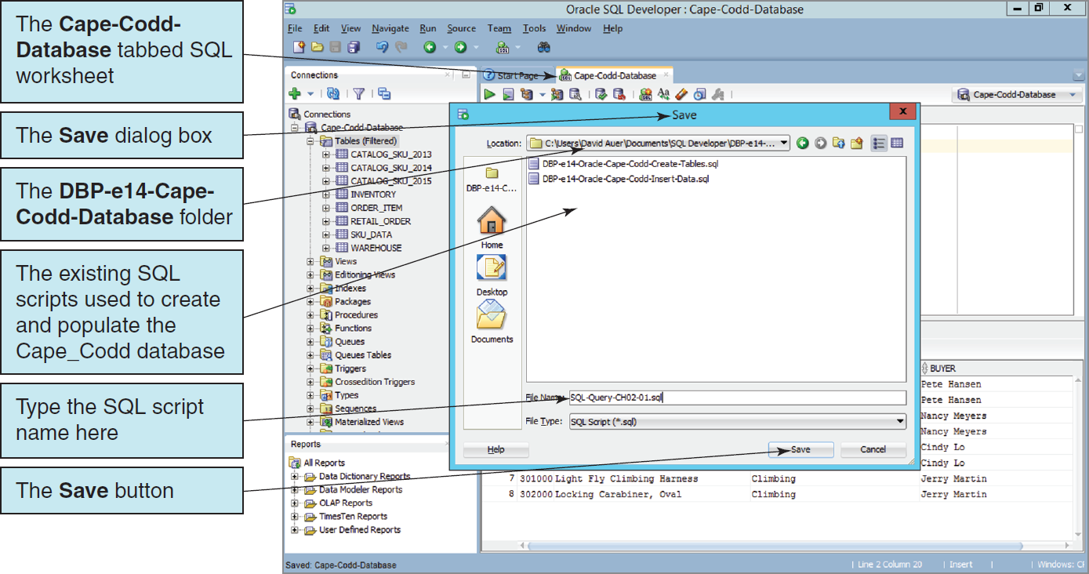
Using Existing SQL Scripts Saving the SQL Query as an SQL Script

Slide 69
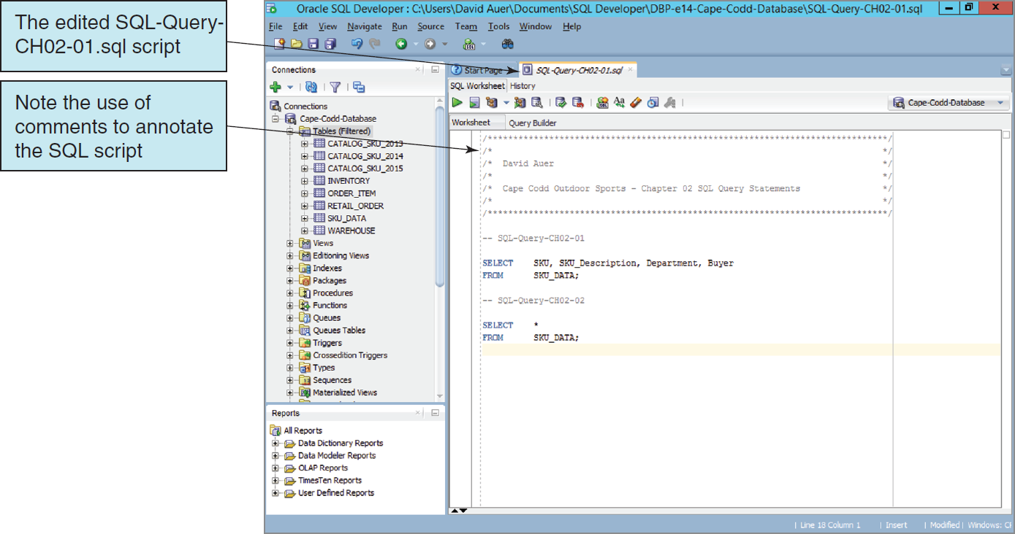
Using a Single SQL Script to Store Multiple SQL Commands The Edited SQL Script

Slide 70
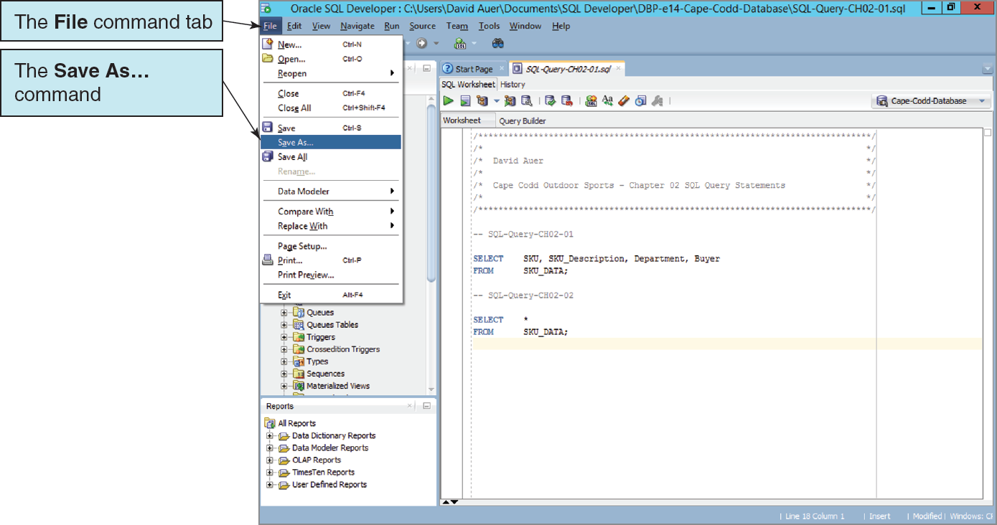
Using a Single SQL Script to Store Multiple SQL Commands The File | Save As . . . Command

Slide 71

Using a Single SQL Script to Store Multiple SQL Commands The Renamed SQL Script
Notes:
At this point, you have covered all the material about Oracle Database that you need to work with the SQL query statements in Chapter 2.
If you worked through this material because of the directions in the Using SQL in Oracle Database section in that chapter, you should return to that section at this time and continue your work on SQL query statements.
Use the new Cape-Codd-Chapter-02-SQL-Queries.sql script to store all your work in Chapter 2—it will be much easier and more efficient than storing a separate SQL script for each query!

Slide 72
David Kroenke and David Auer Database Processing Fundamentals, Design, and Implementation (14th Edition)
End of Presentation:
Chapter Ten B Part 1

Slide 73

All rights reserved. No part of this publication may be reproduced, stored in a retrieval system, or transmitted, in any form or by any means, electronic, mechanical, photocopying, recording, or otherwise, without the prior written permission of the publisher. Printed in the United States of America.

